Slide 1
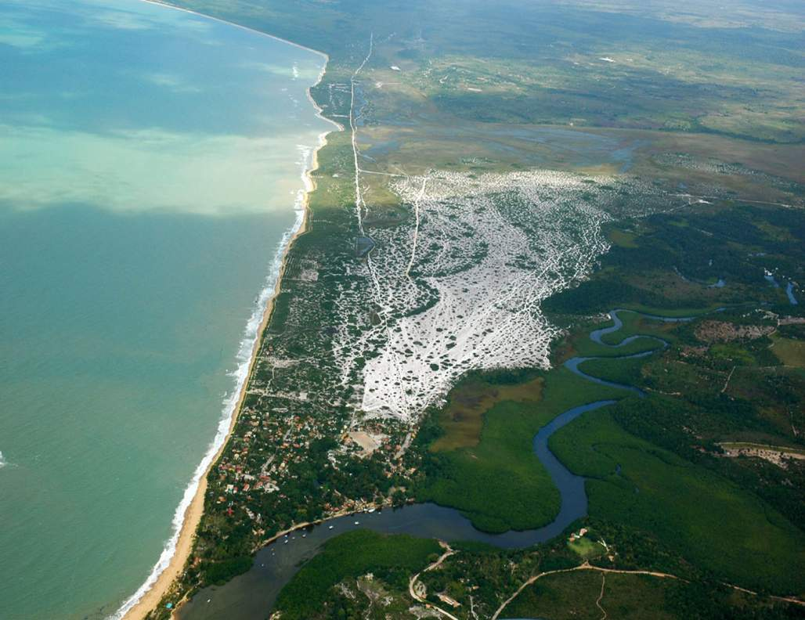


Brazil’s
Northeast Coast

Slide 2
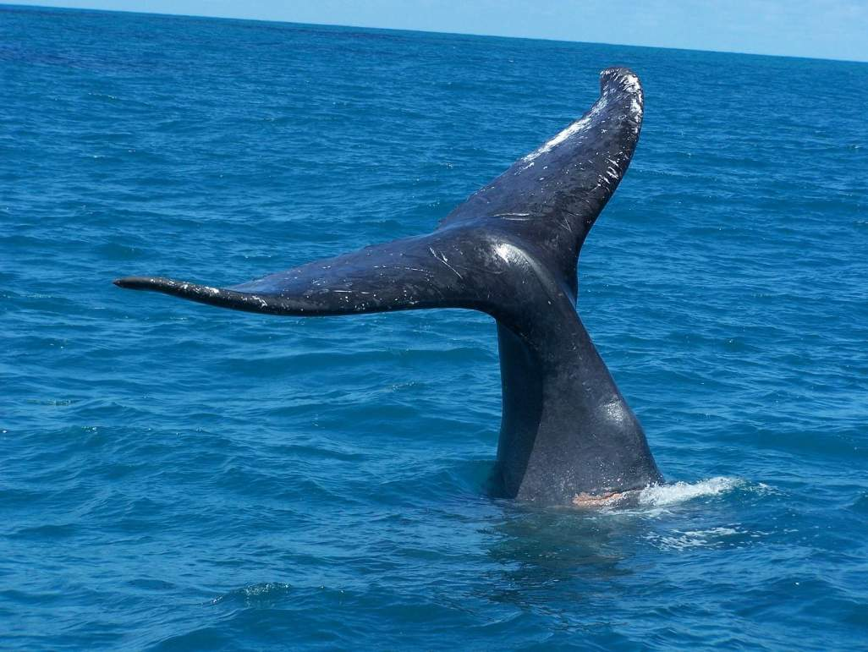

  The Northeast Region of Brazil comprises 1,5 million square kilometers and represents 18% of Brazilian territory. It possesses the longest Atlantic Coast of the country with 3.338 km of beaches stretching from Maranhão to Southern Bahia. Among the 9 Northeastern states, Bahia has the longest coastline with 932 km.

Slide 3
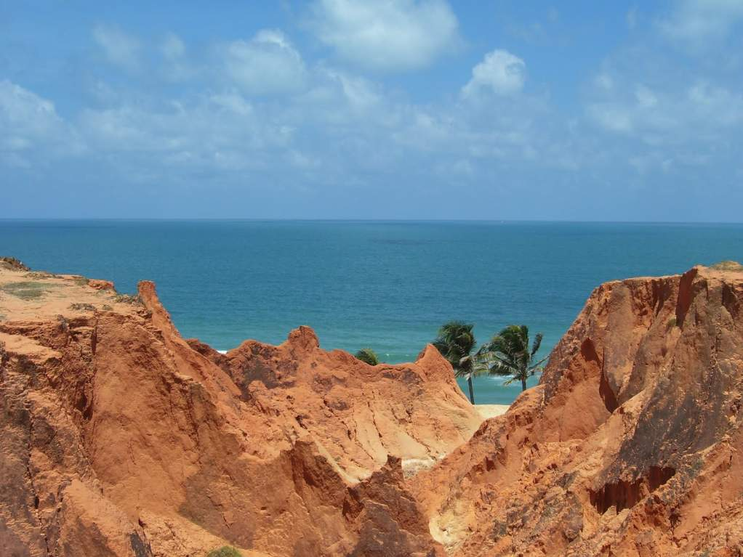

Slide 4
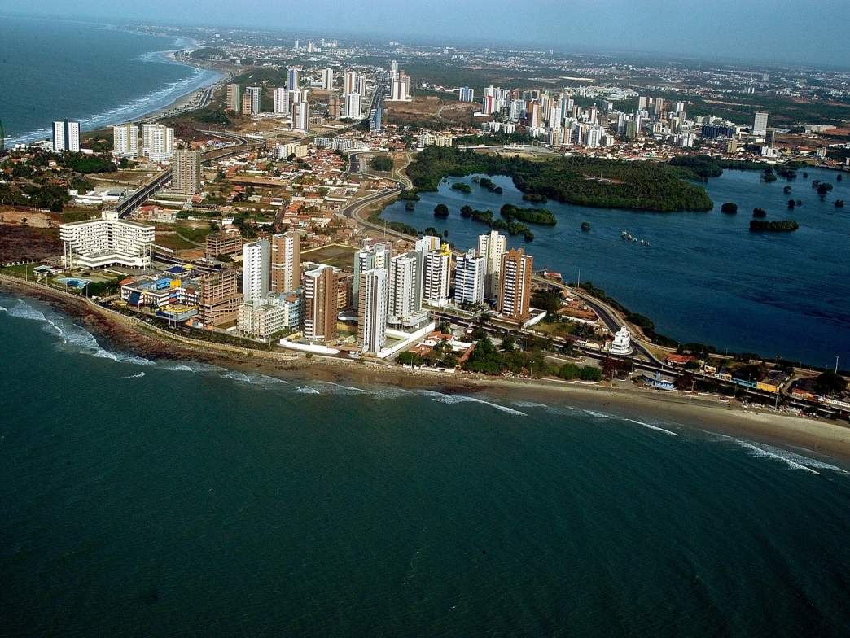
Maranhão
São Luis

Slide 5
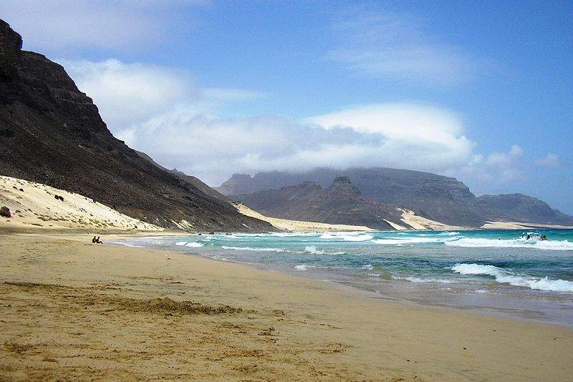
Praia do Calhau

Slide 6
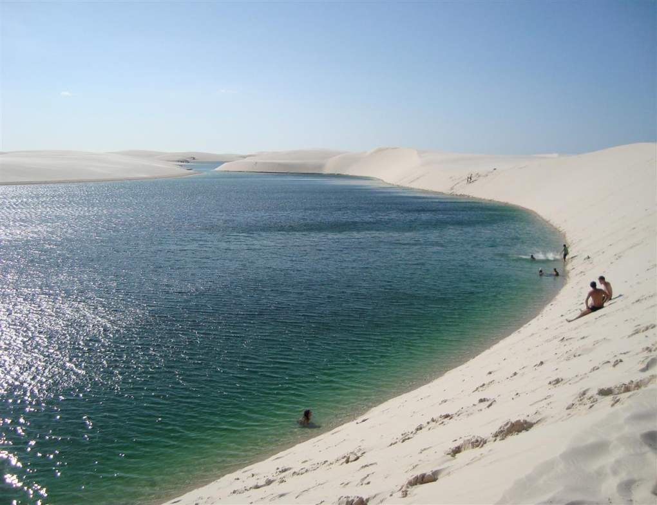
Lagoa Azul – Lençois Maranhenses

Slide 7
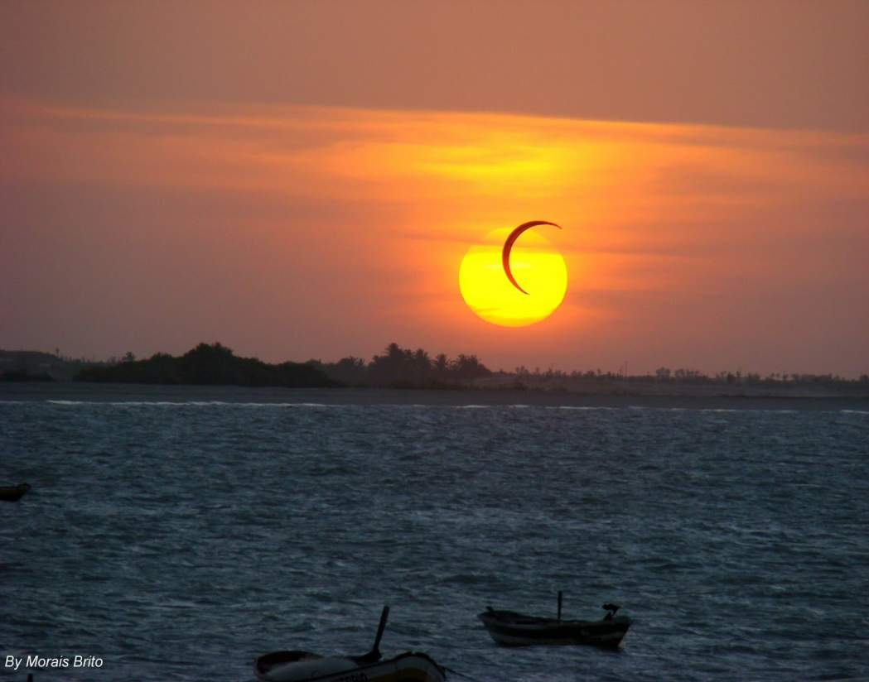
Piaui´

Slide 8
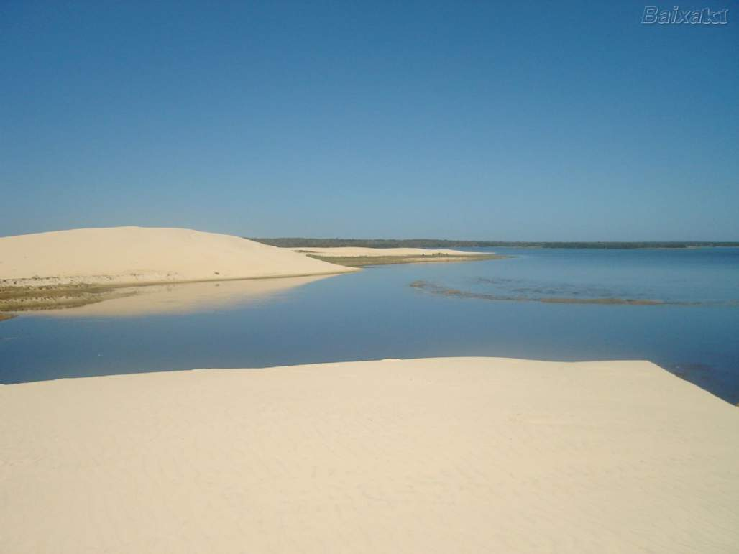
Delta do Parnaiba

Slide 9
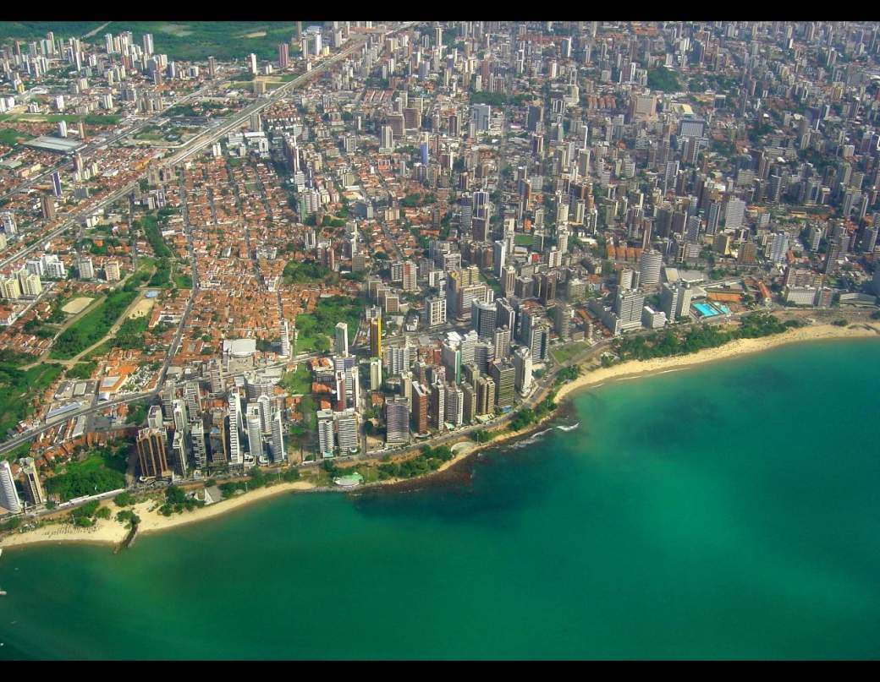
Ceará
Fortaleza

Slide 10
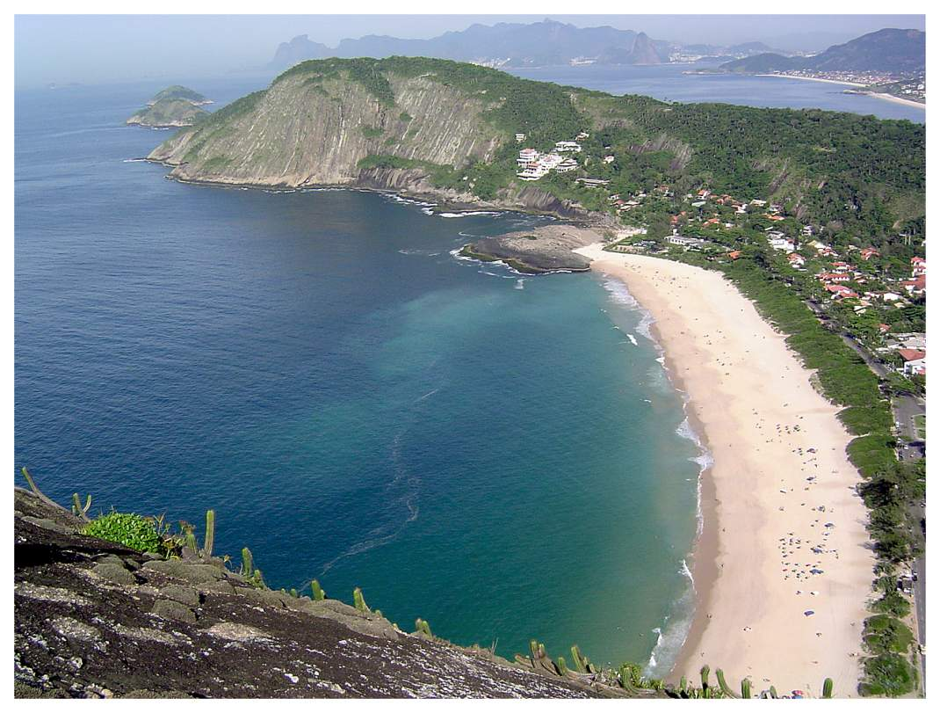

Slide 11
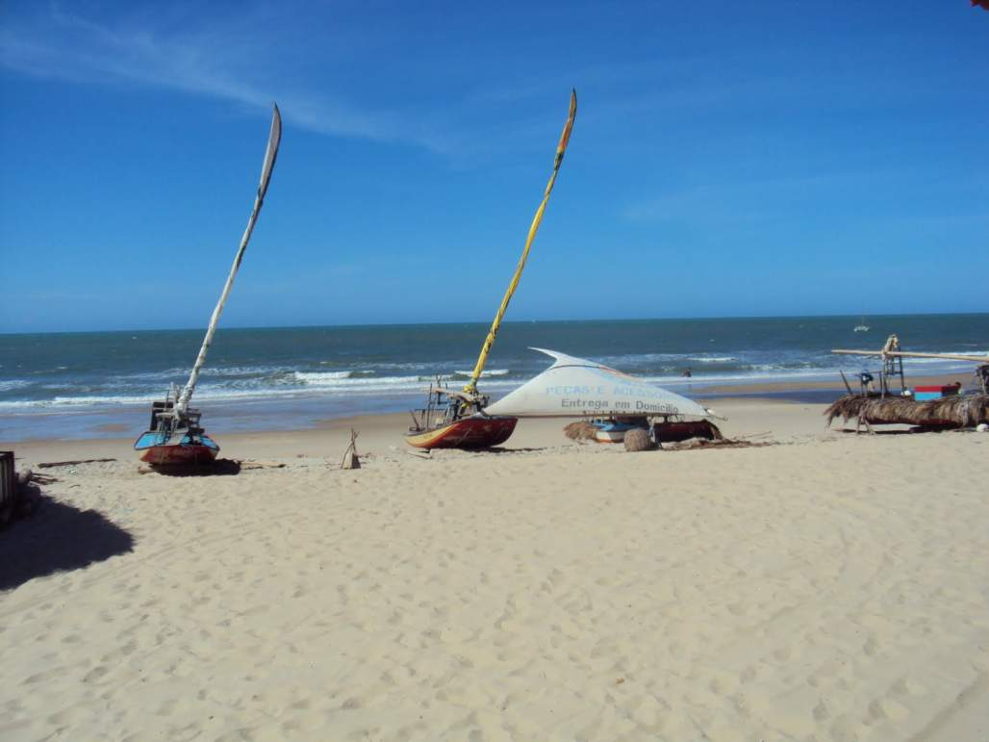

Slide 12
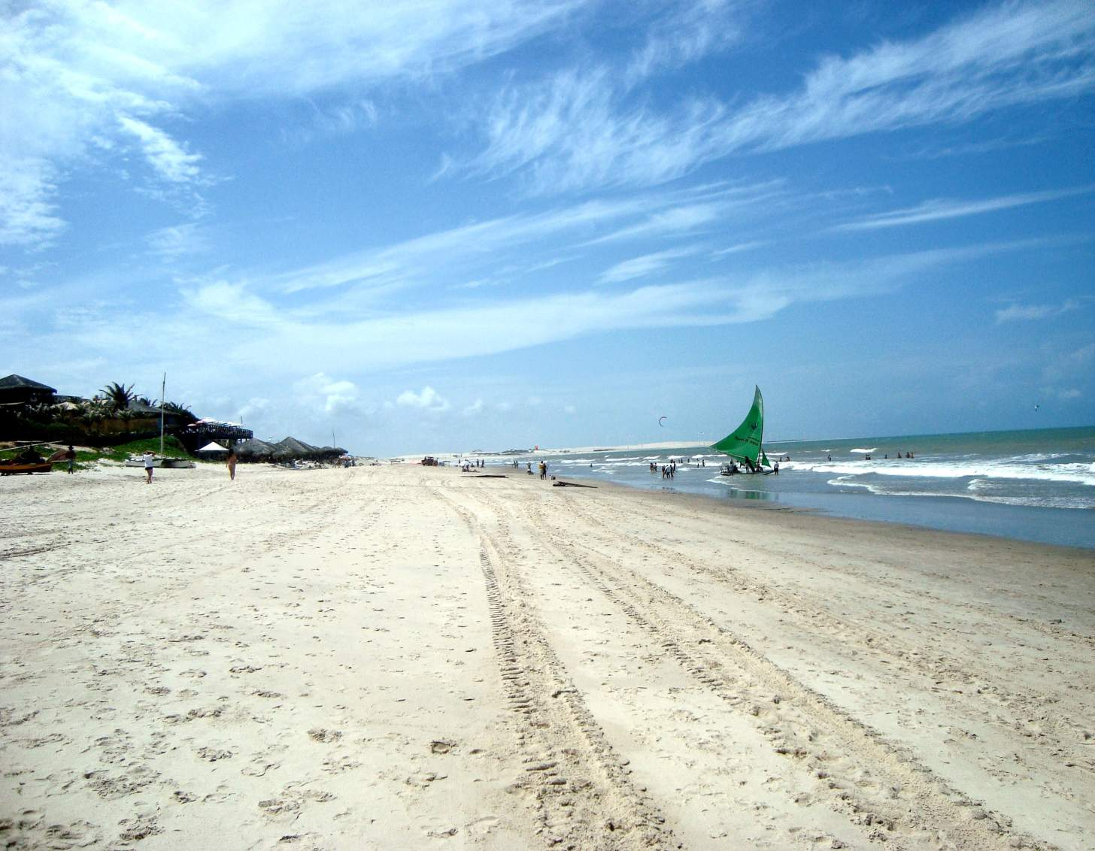

Slide 13
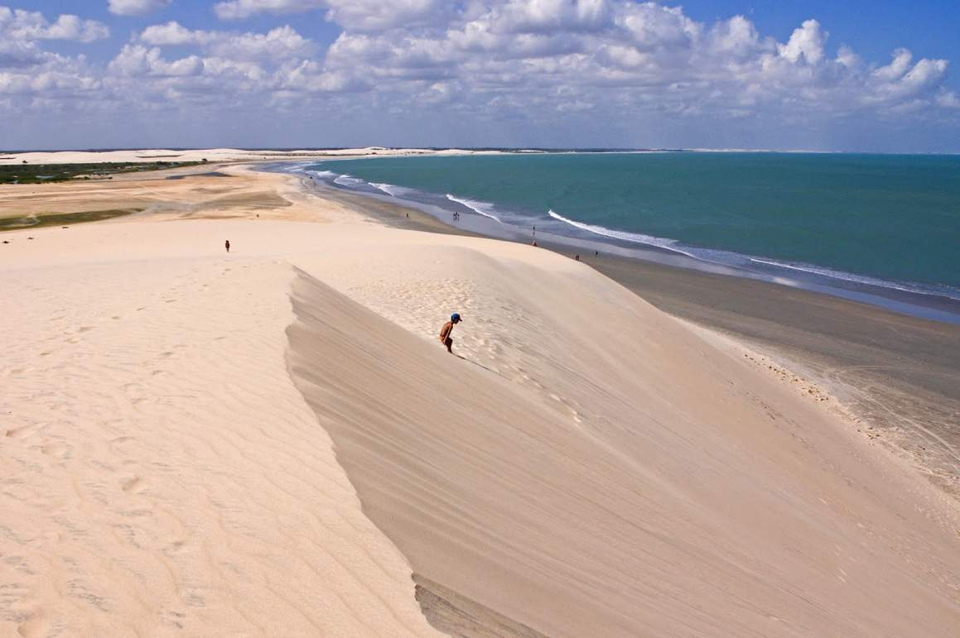
Jericoacoara

Slide 14
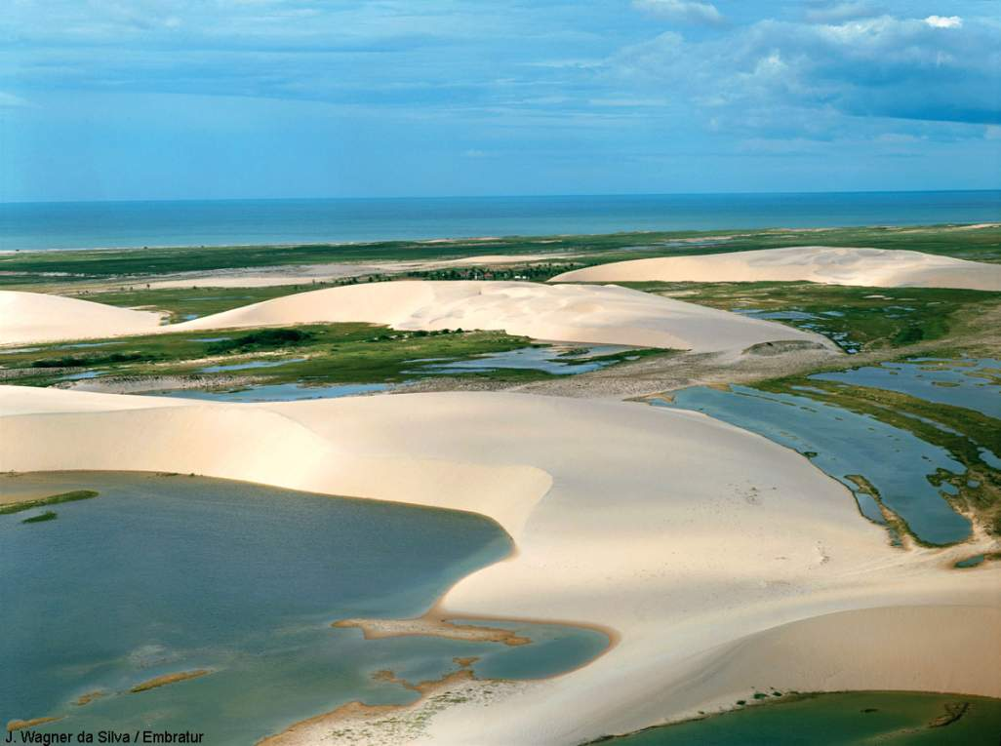

Slide 15
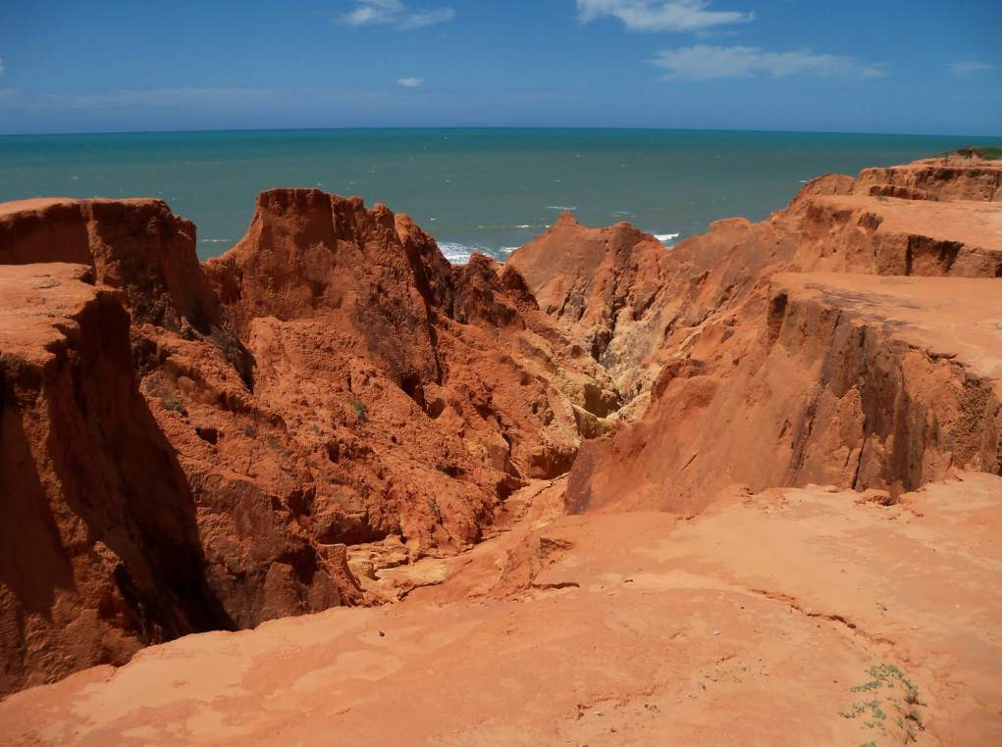


Slide 16
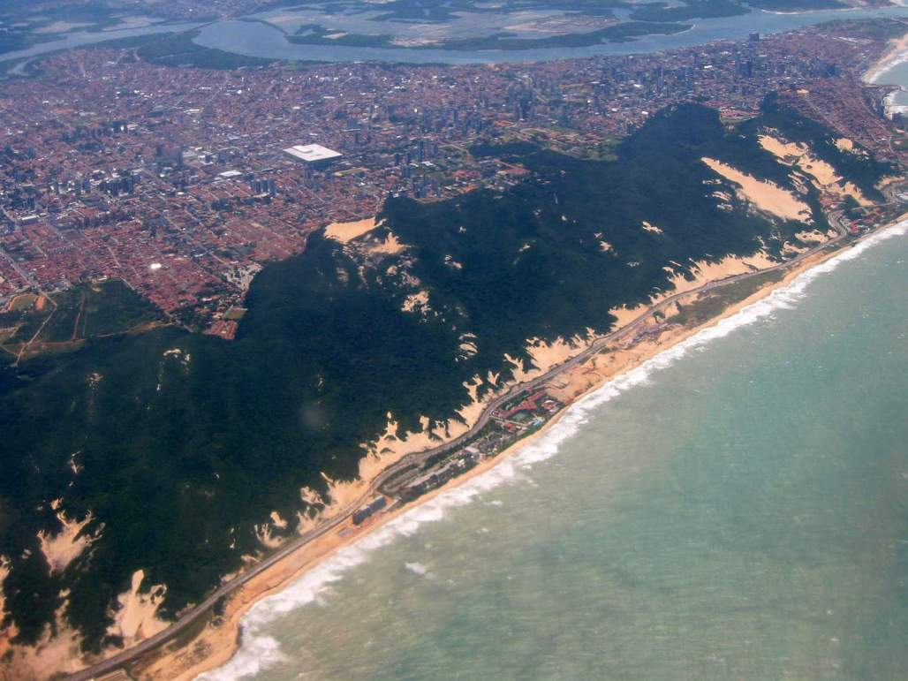
Rio Grande do Norte
Natal

Slide 17
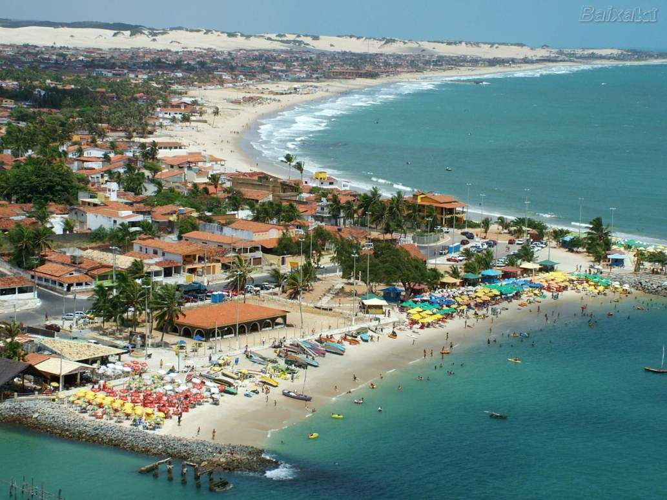
Natal

Slide 18
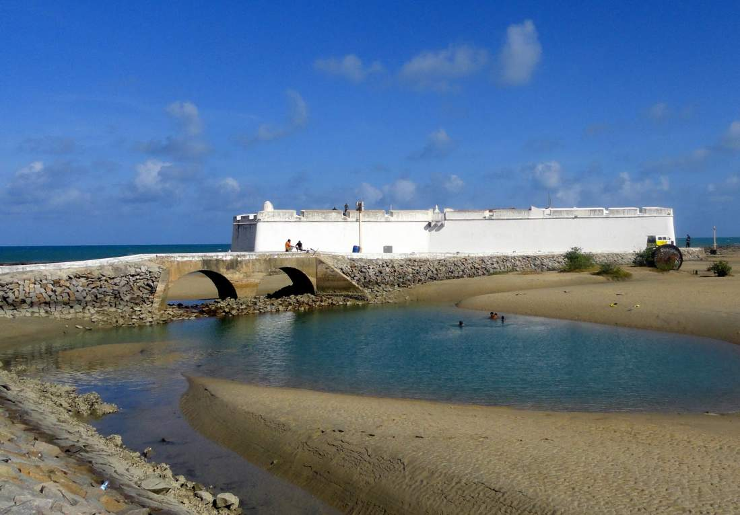
Natal

Slide 19
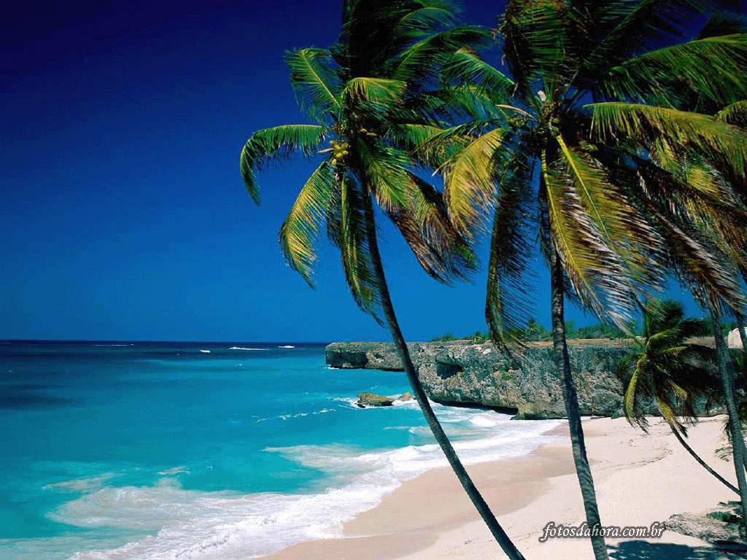
Praia da Pipa

Slide 20
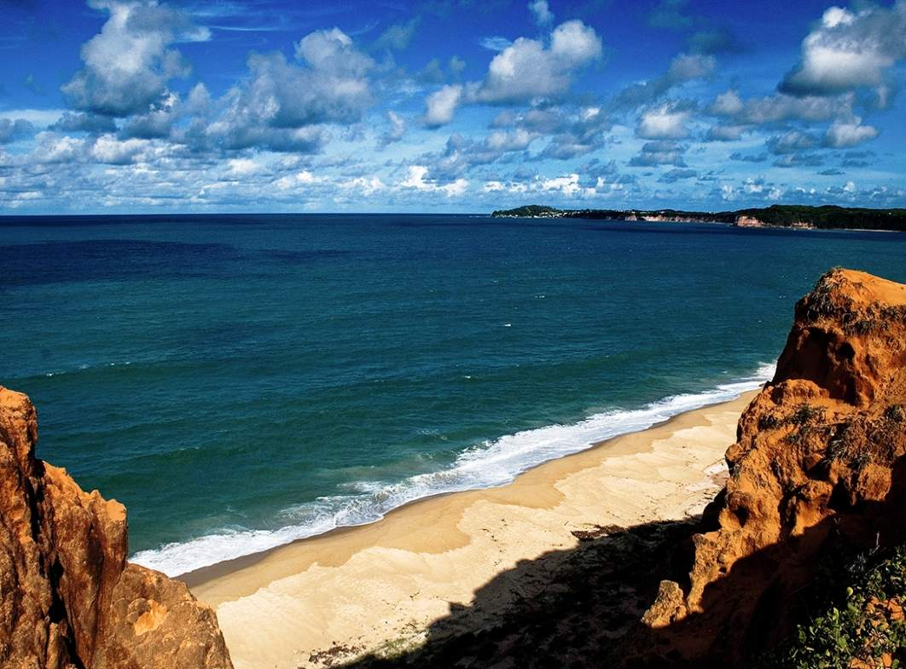
Pipa

Slide 21
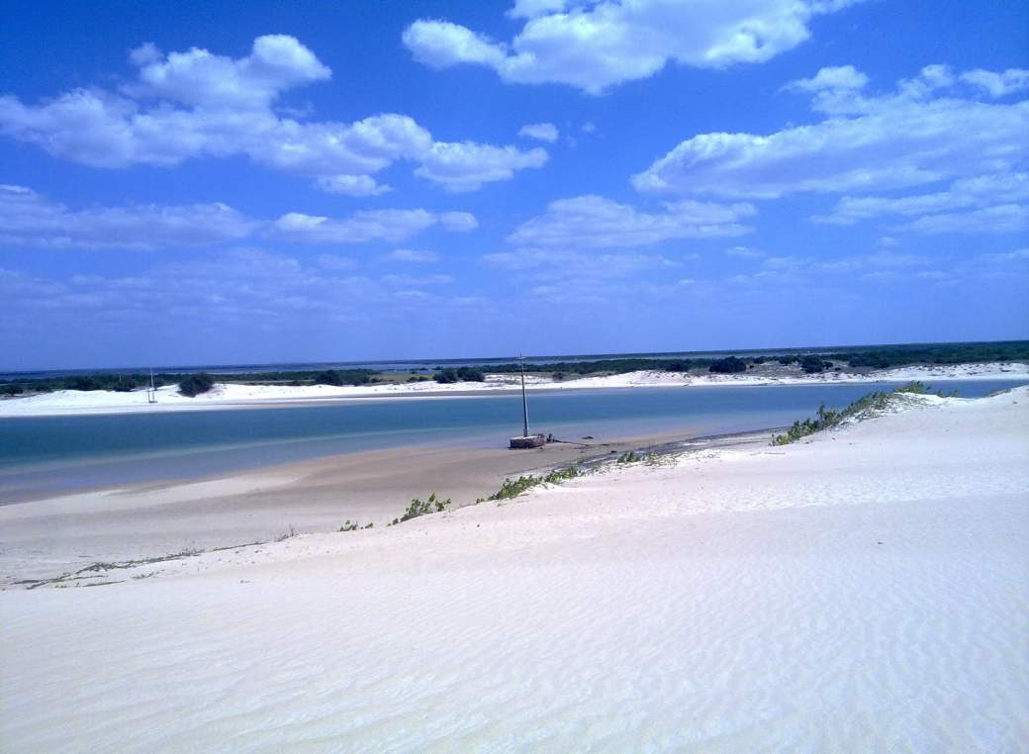
Galinhos

Slide 22
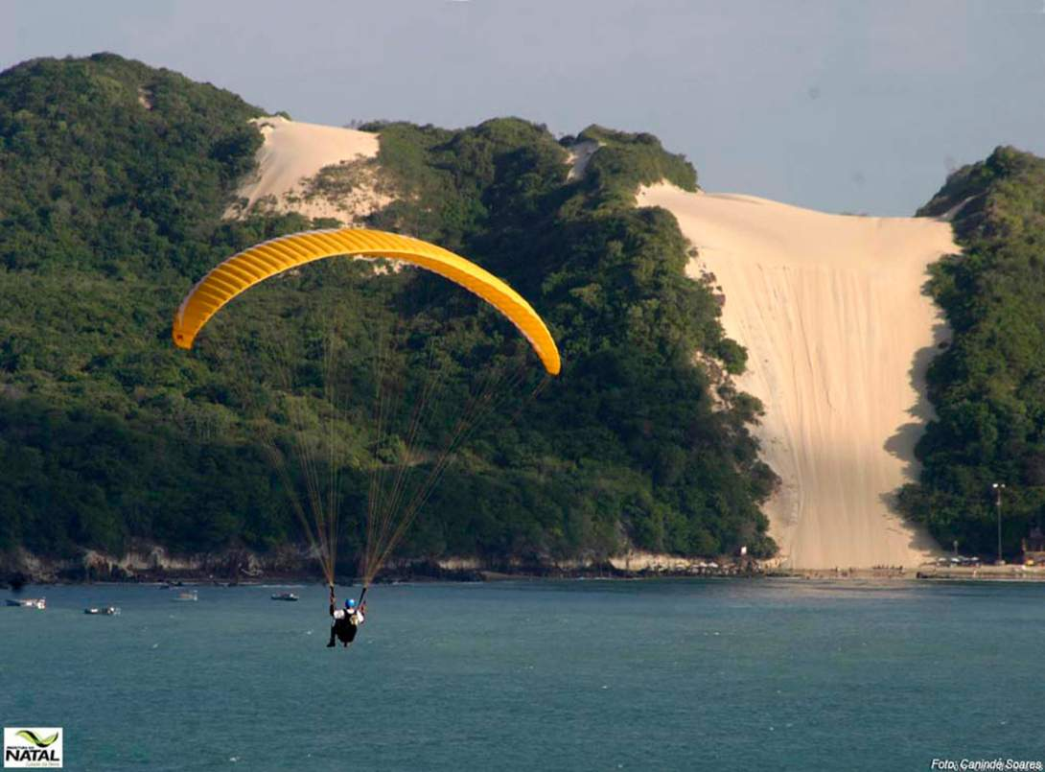
Ponta Negra

Slide 23
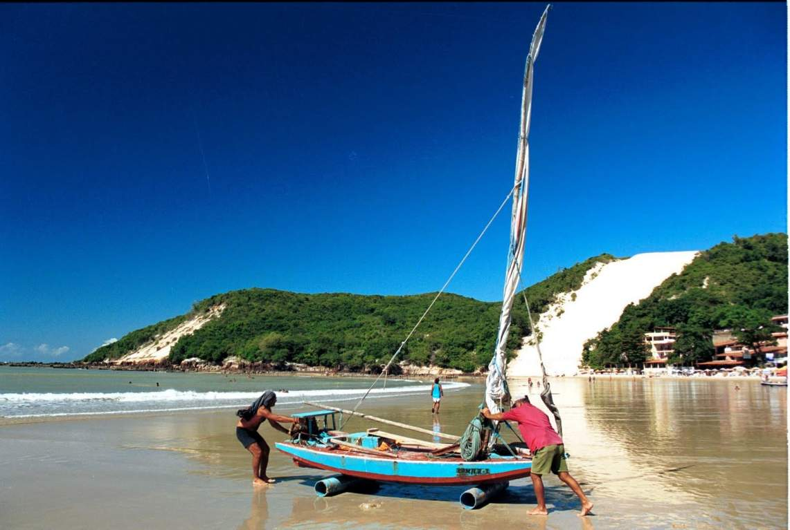

Slide 24
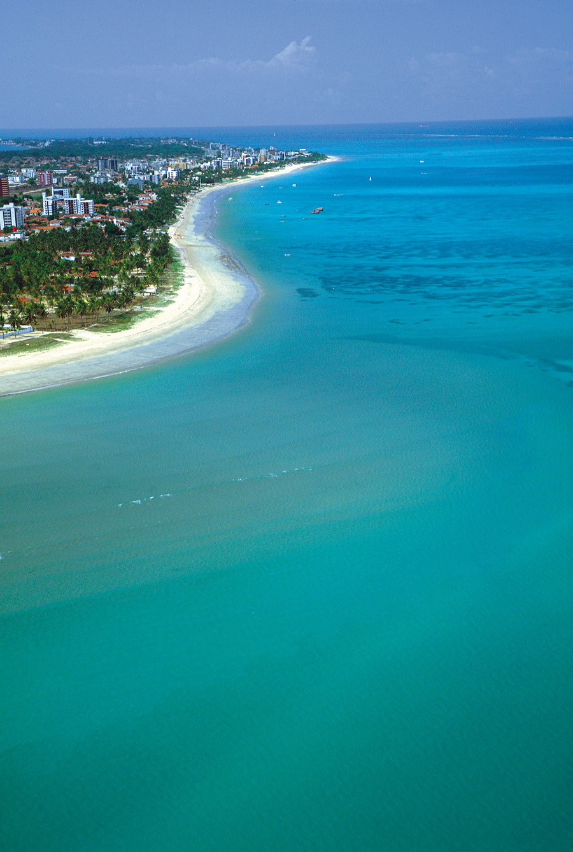
Paraiba
Joao Pessoa

Slide 25
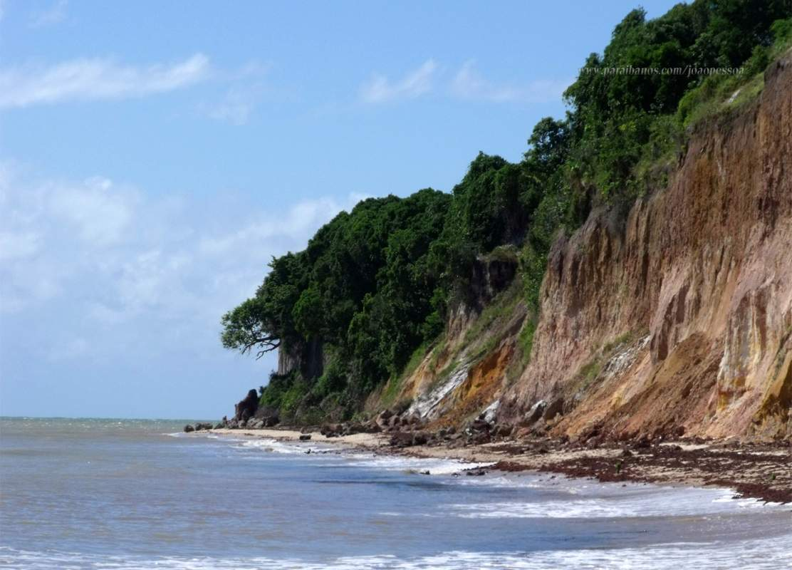
Cabo Branco

Slide 26
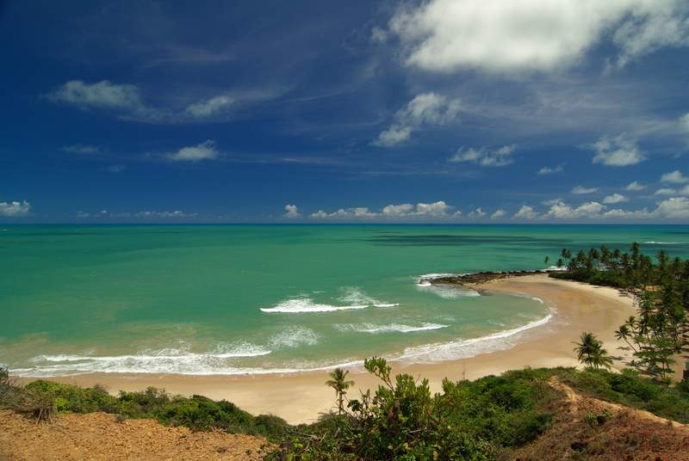
Coqueirinho

Slide 27
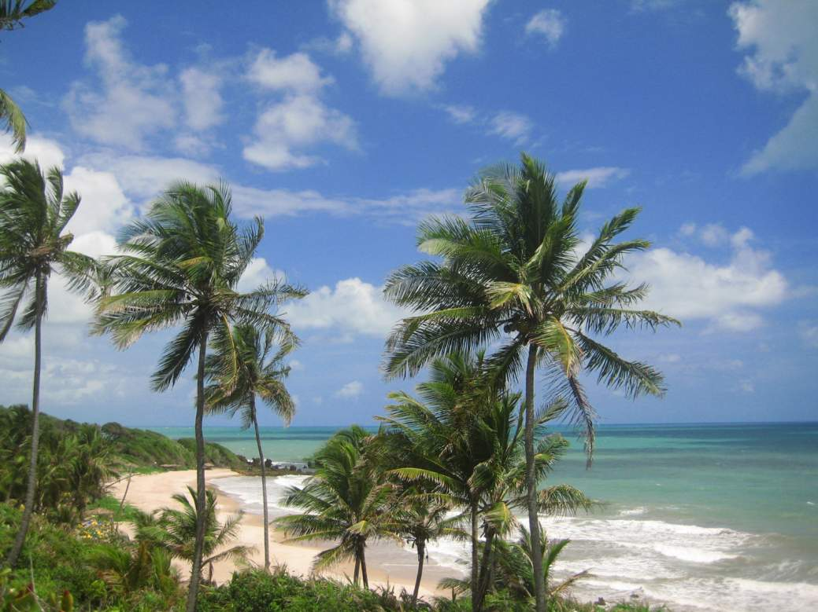
Tambaba

Slide 28
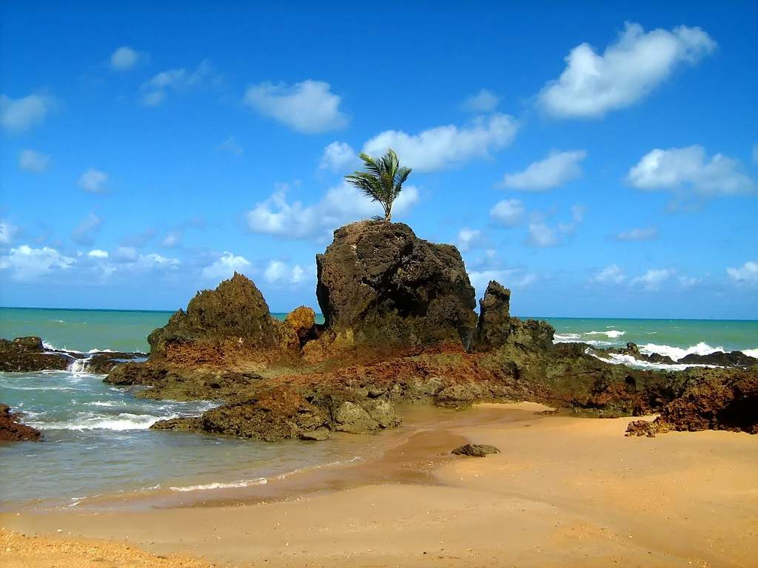
Tambaba

Slide 29
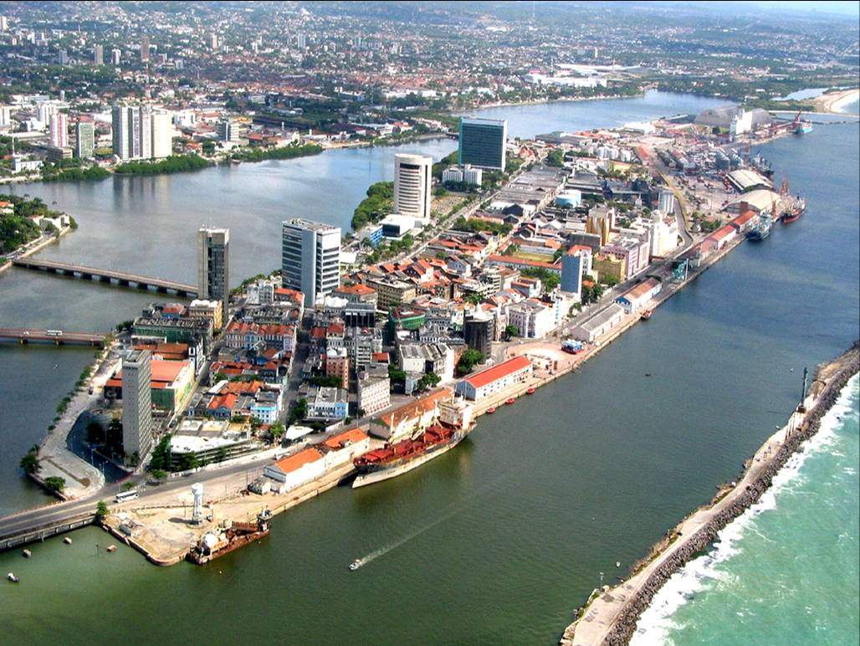
Pernambuco
Recife

Slide 30
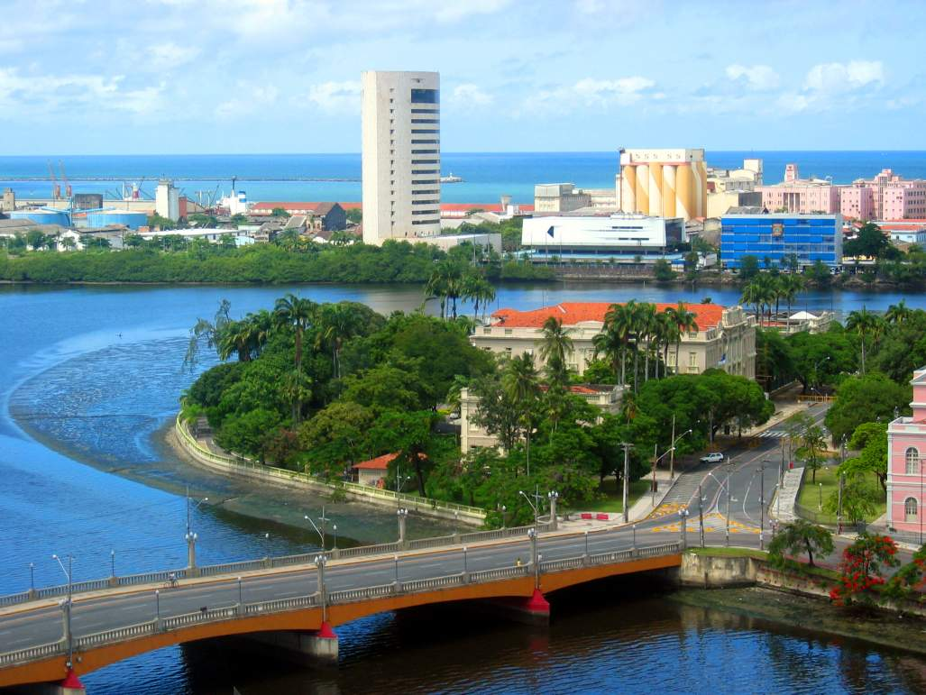

Slide 31
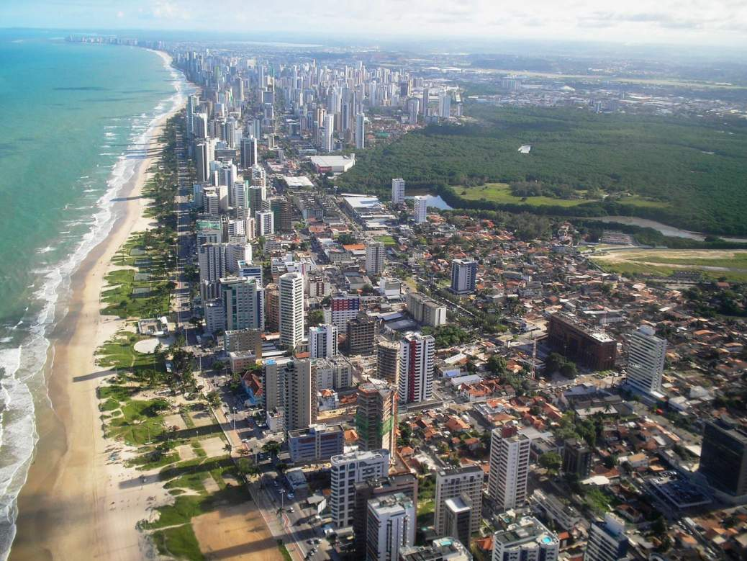
Boa Viagem

Slide 32
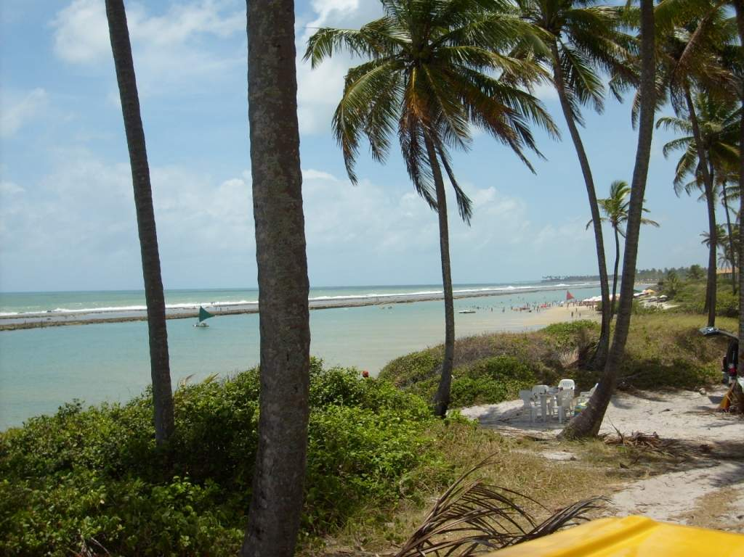

Slide 33
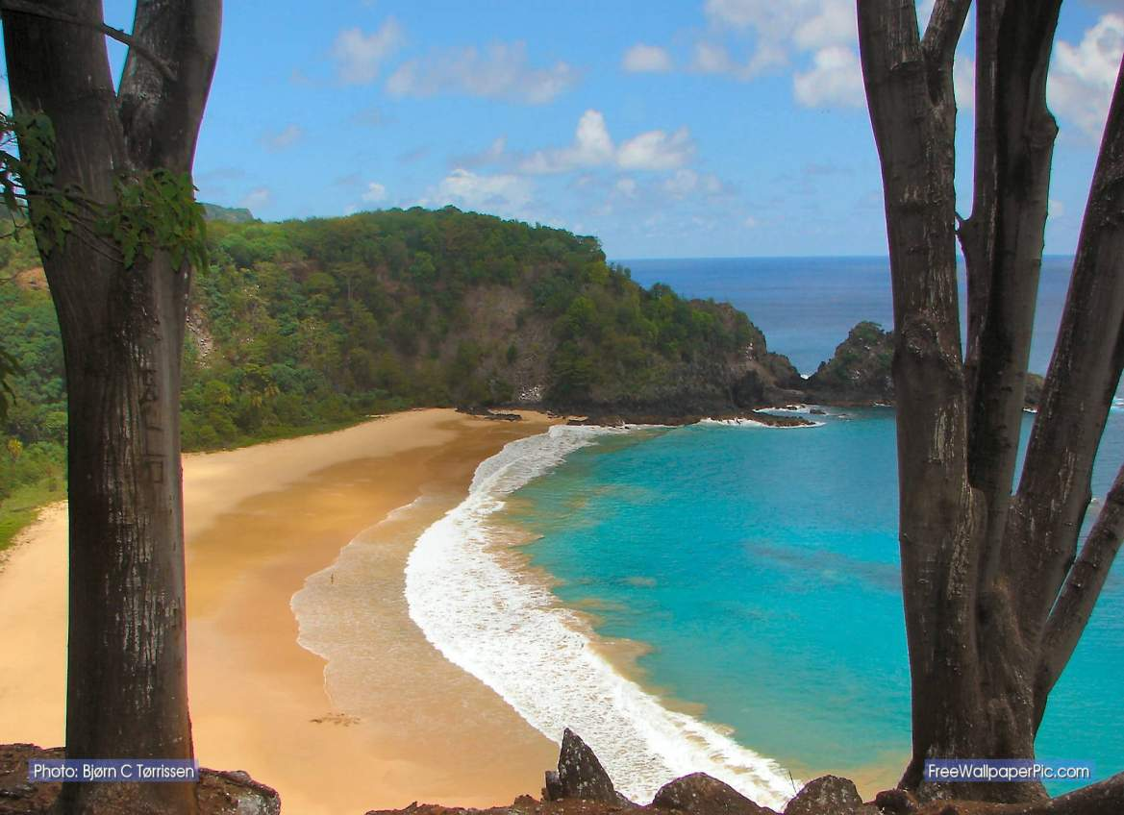
Praia do Sancho –Fernando de Noronha

Slide 34
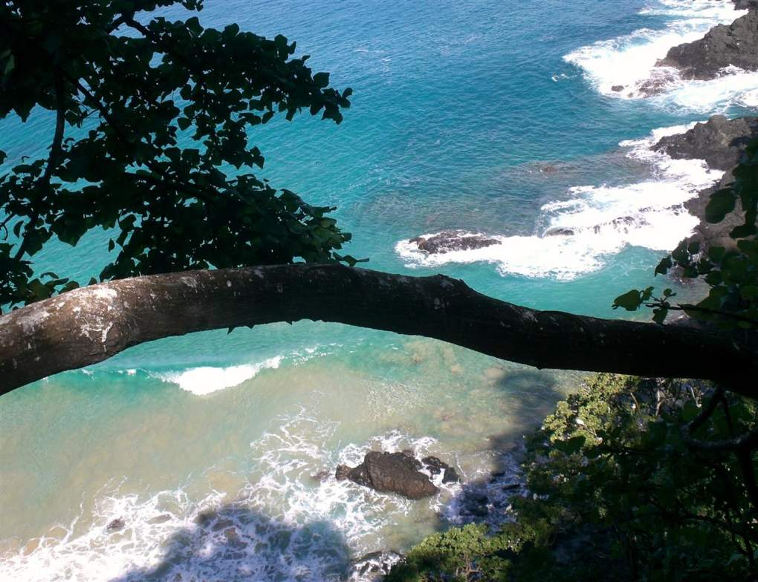

Slide 35
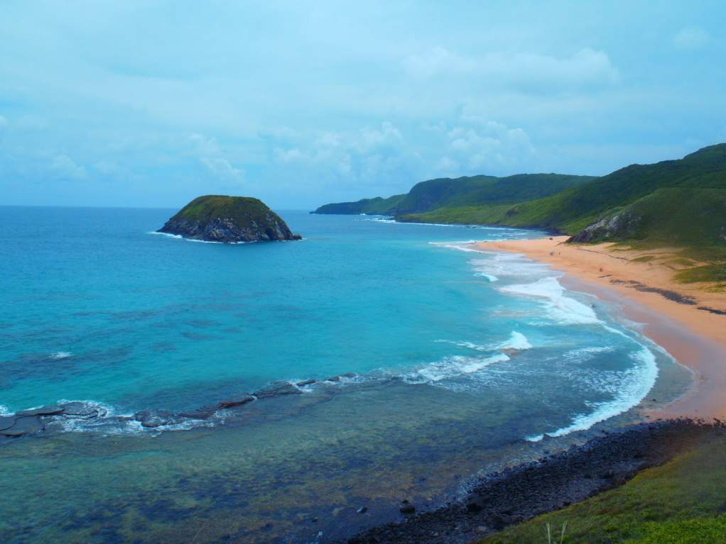

Slide 36
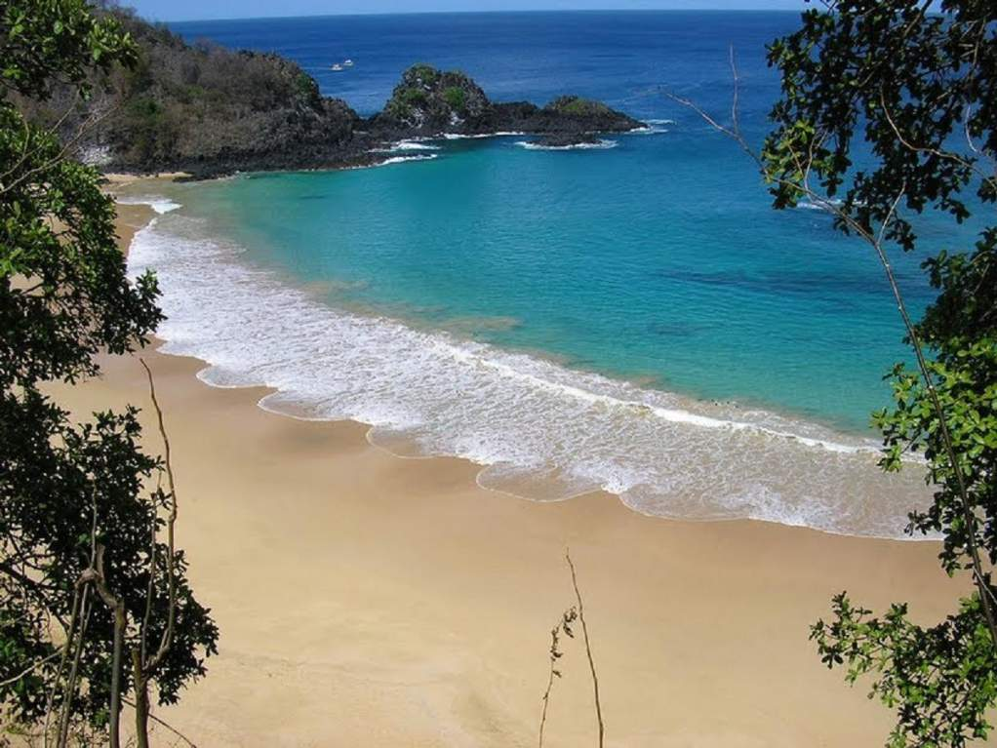
Baia do Sancho

Slide 37
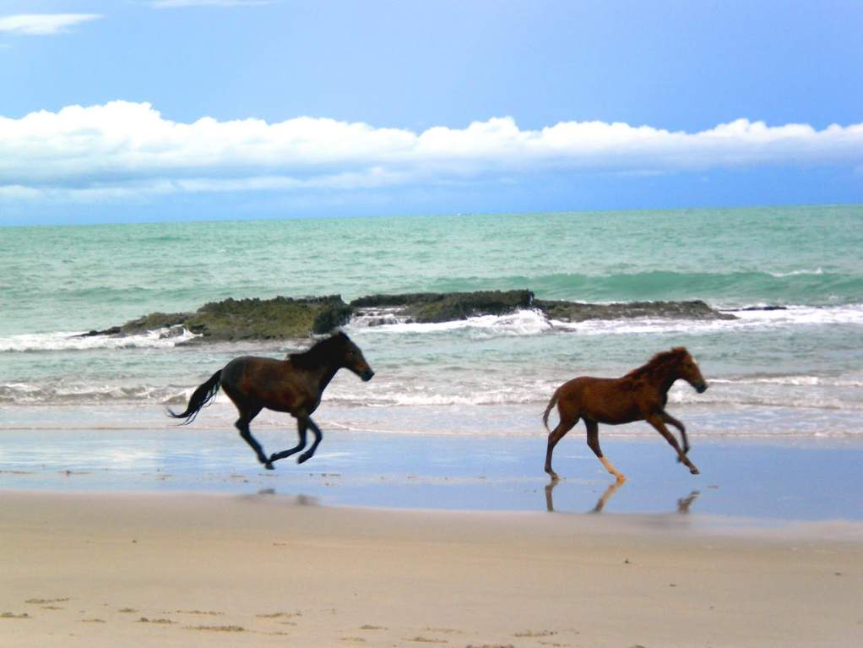
Praia dos Carneiros

Slide 38
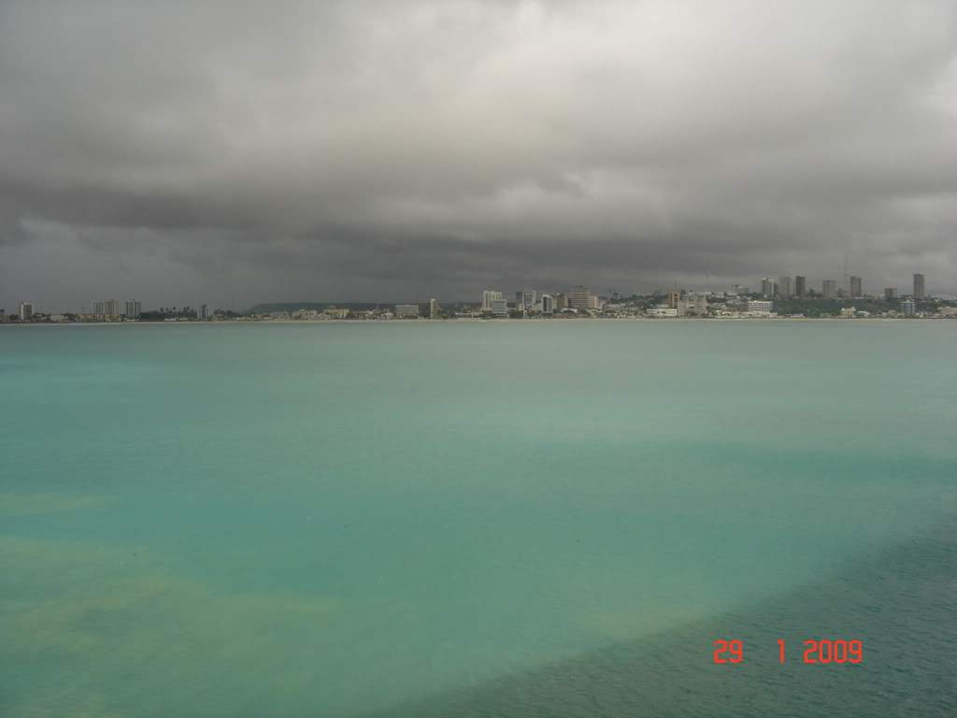
Alagoas
Maceió

Slide 39
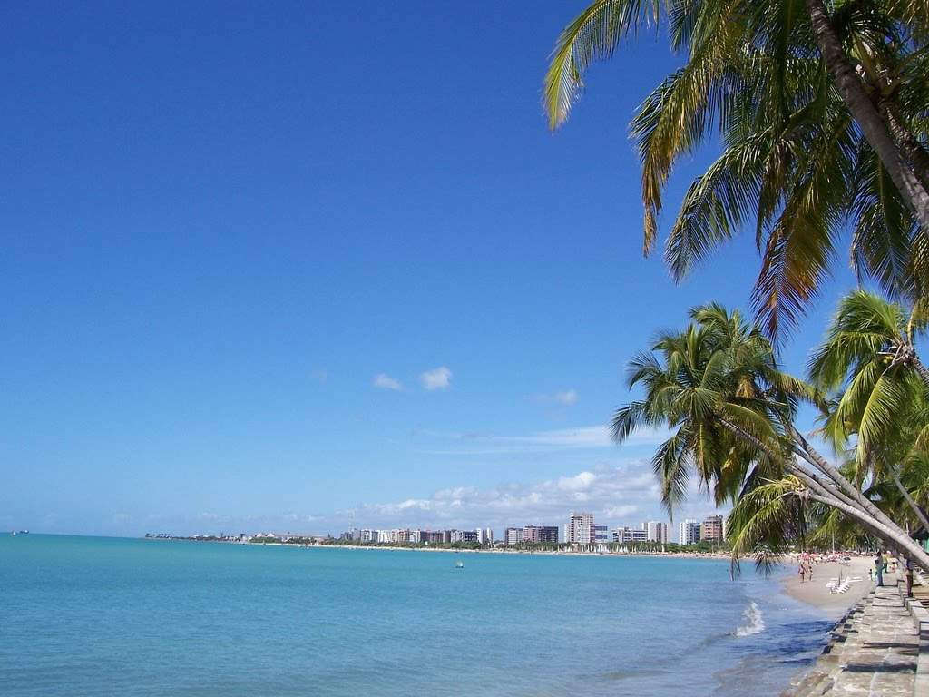
Maceió

Slide 40
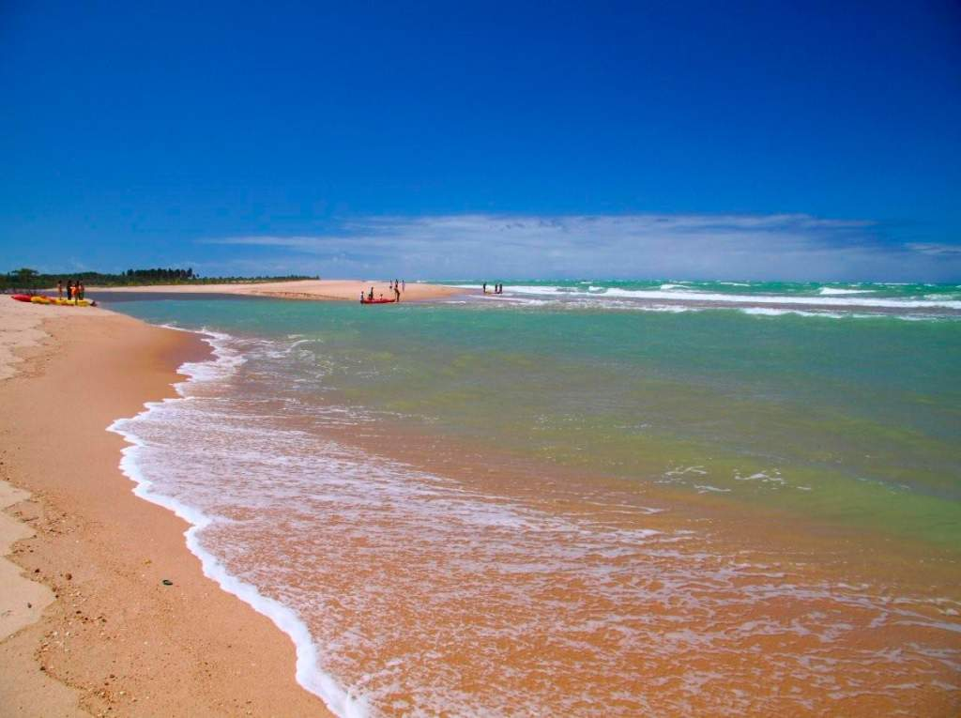

Slide 41
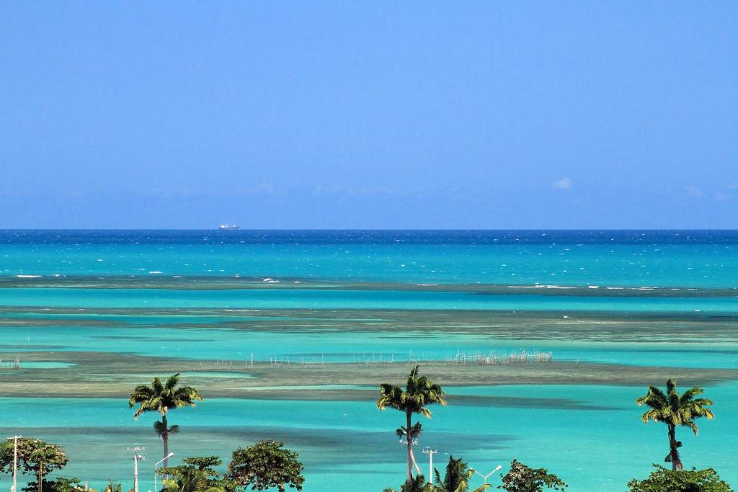
Pajuçara

Slide 42
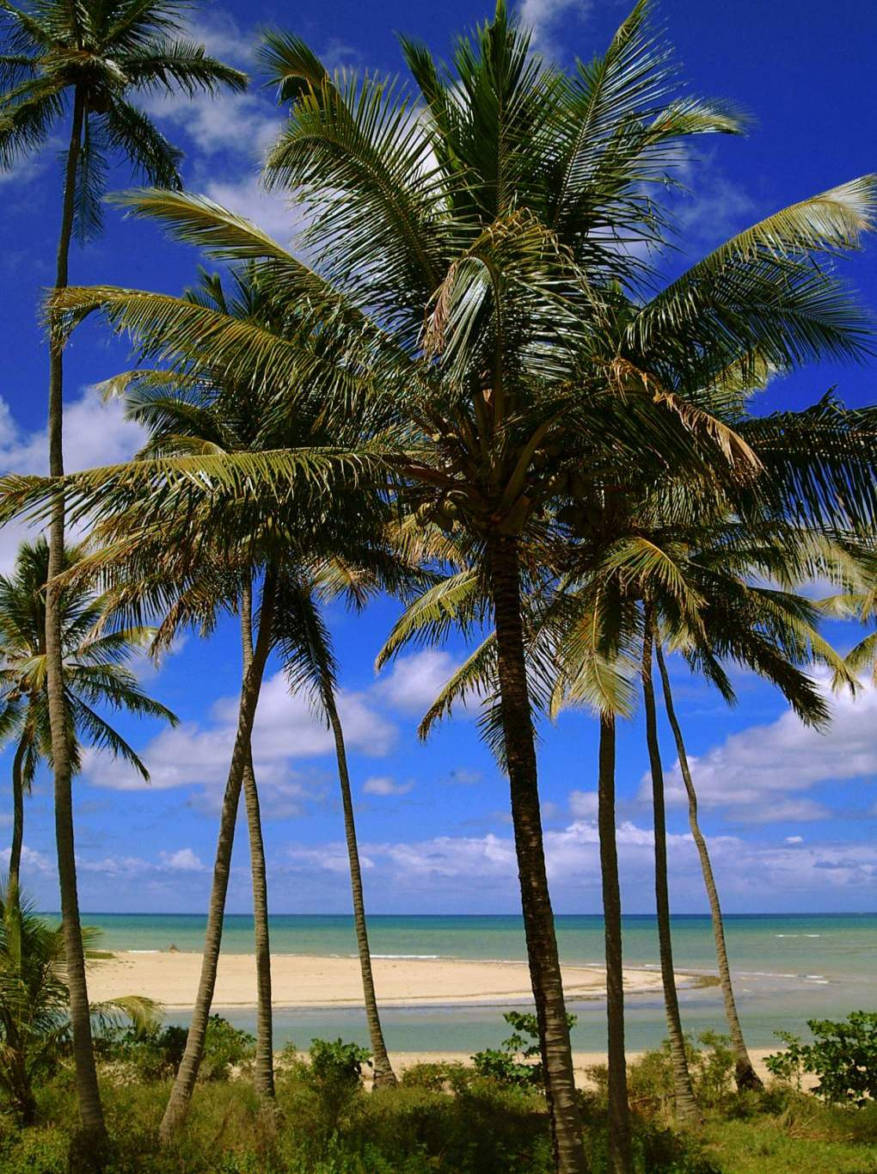

Slide 43
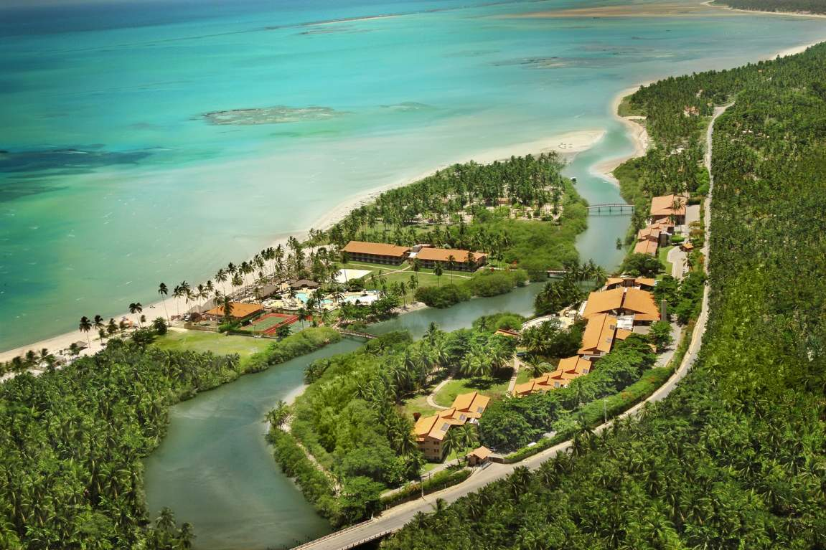

Slide 44
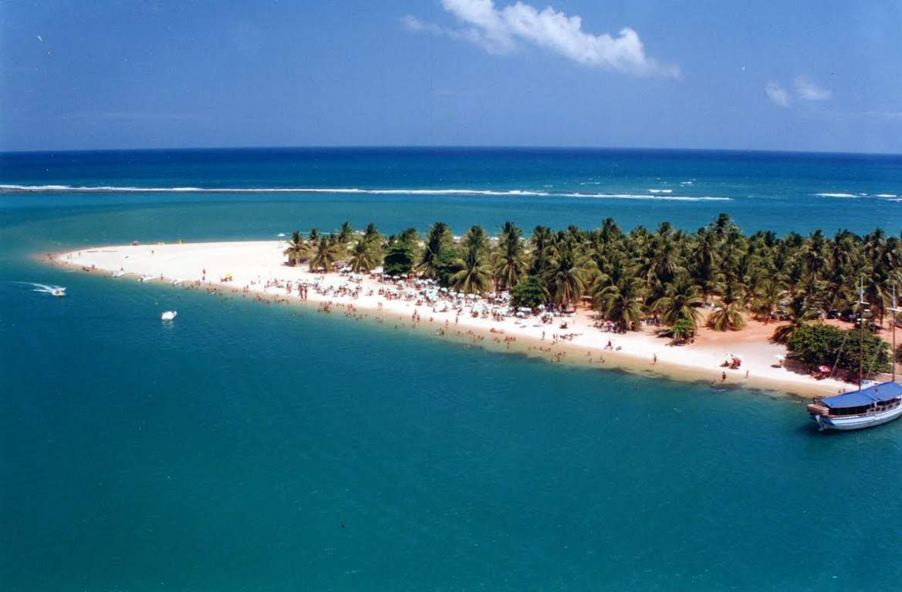
Praia do Gunga

Slide 45
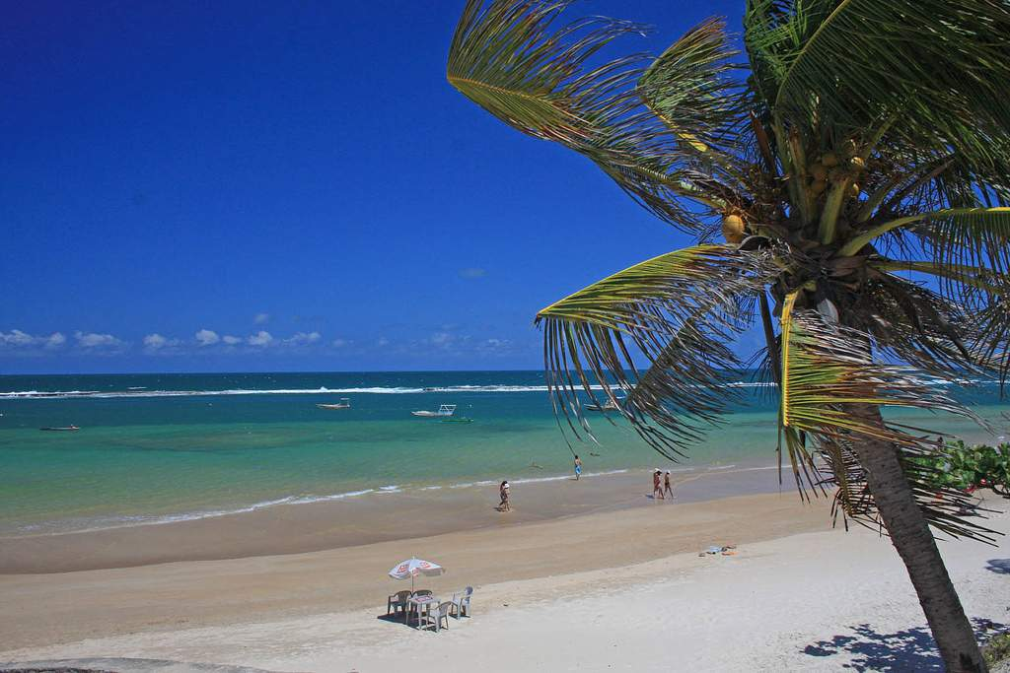

Slide 46
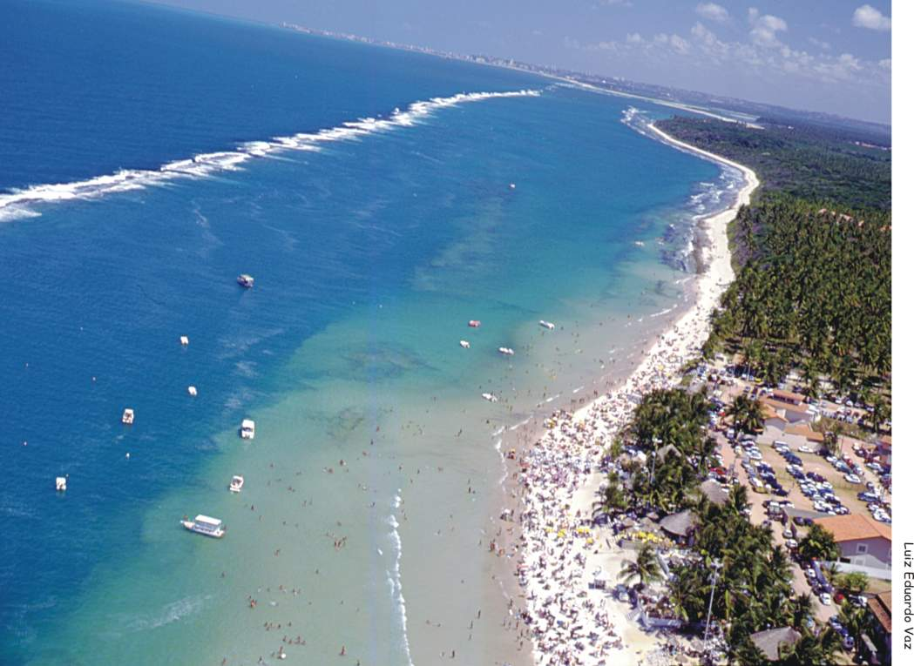
Praia do Francês

Slide 47
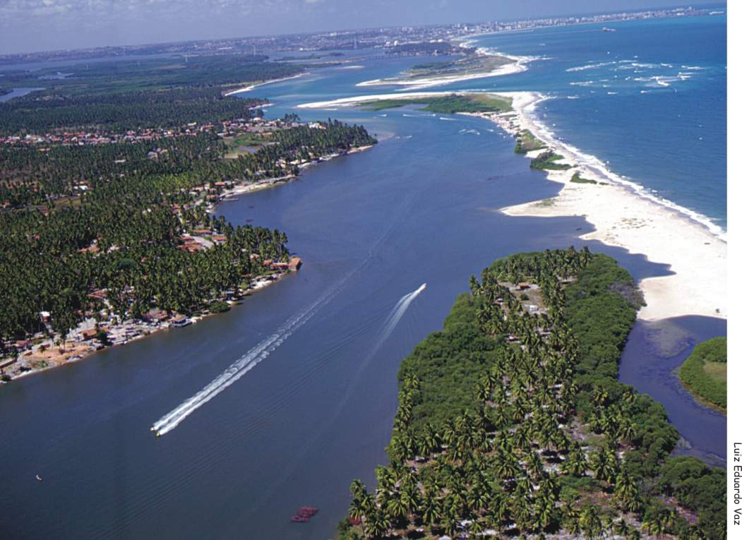
Piranha

Slide 48
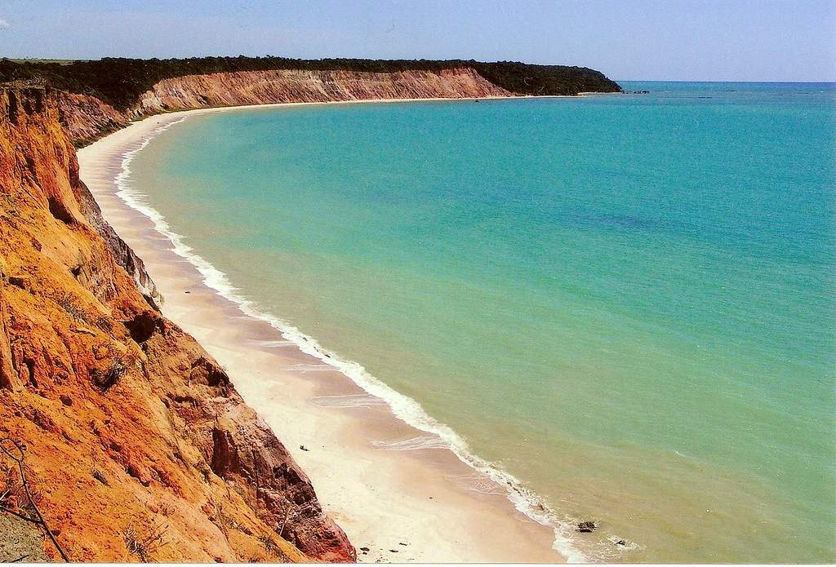
Praia do Carro Quebrado

Slide 49
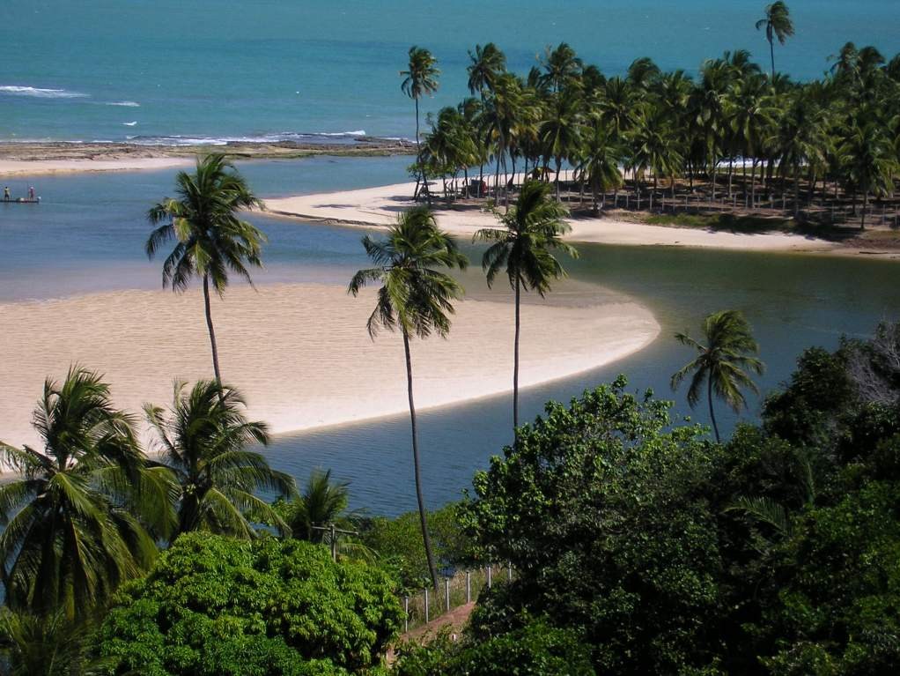
Jequiá da Praia

Slide 50
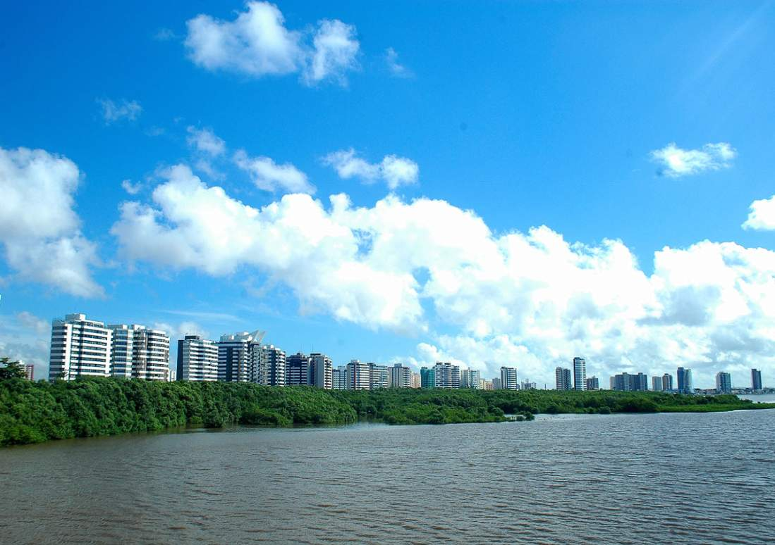

Aracaju

Slide 51


Slide 52


Slide 53


Salvador

Slide 54

Mangue Seco

Slide 55

Imbassai

Slide 56

Ilha de Itaparica

Slide 57

Morro de São Paulo

Slide 58

Ilha dos Tubaroes - Marau

Slide 59

Ilhéus - Cocoa Coast major town

Slide 60

Ilheus

Slide 61

Ilhéus

Slide 62

Porto Seguro

Slide 63

Porto Seguro

Slide 64



Slide 65


Slide 66

Trancoso

Slide 67

Santa Cruz de Cabralia

Slide 68

Abrolhos
LP

Slide 69

END SHOW
Seen on Bigfun.be
Author: Lilibeth

