Slide 1
Island
SYMI
Greece

Slide 2
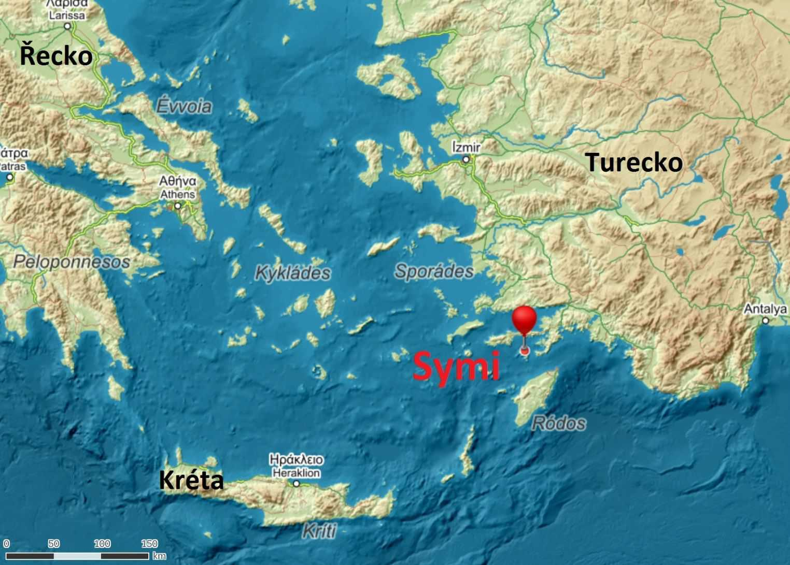

Slide 3
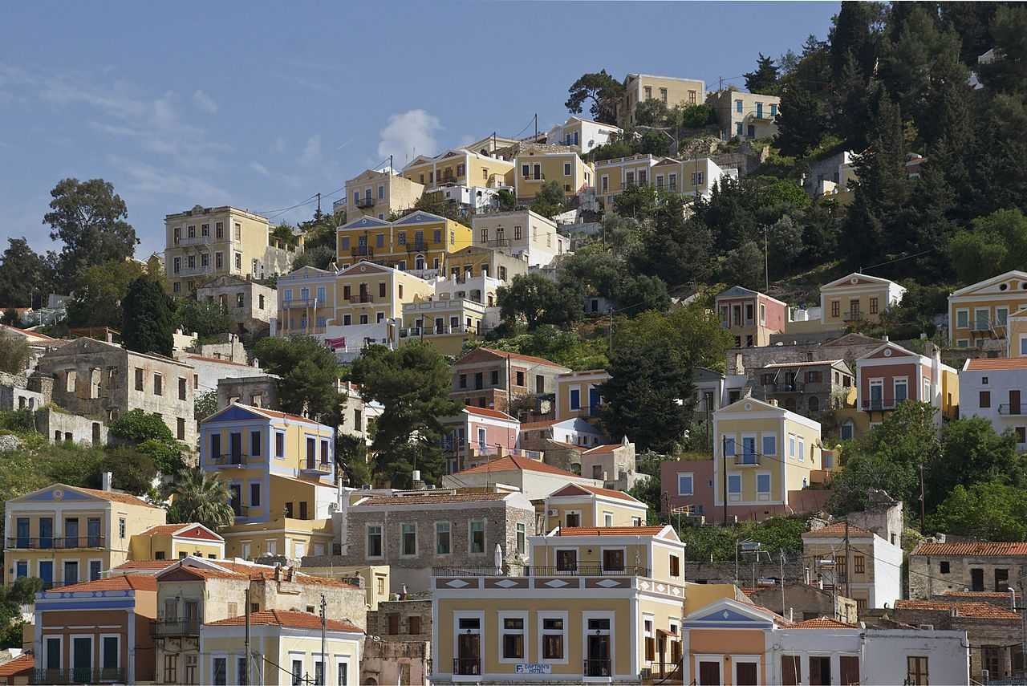

Slide 4
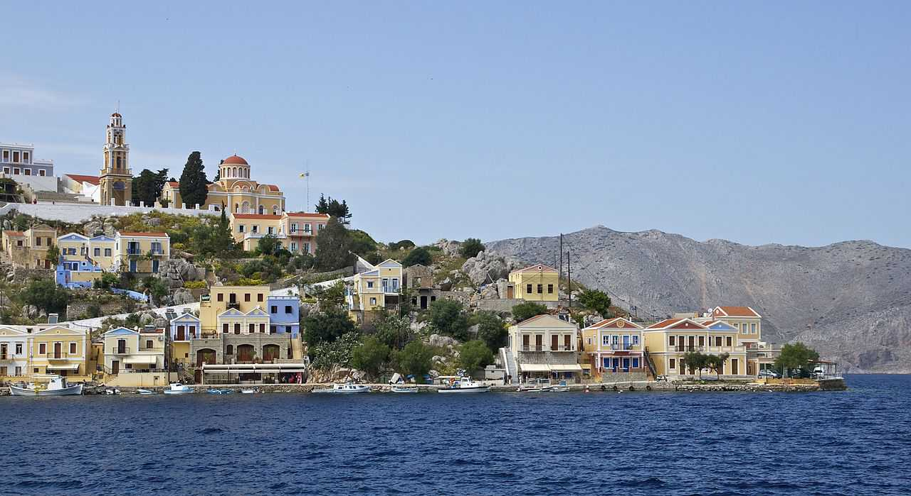

Slide 5
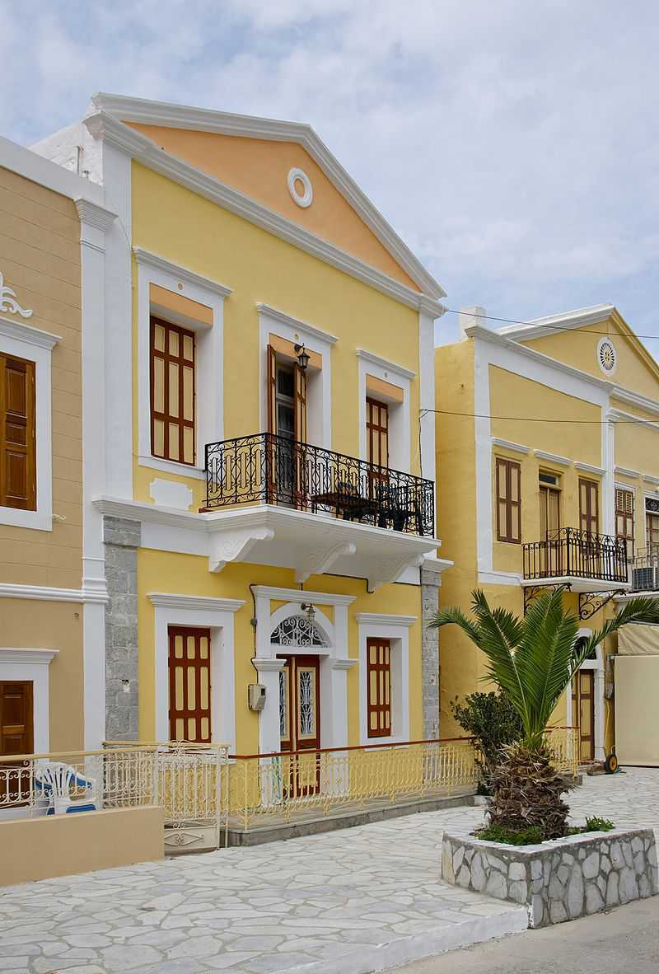

Slide 6
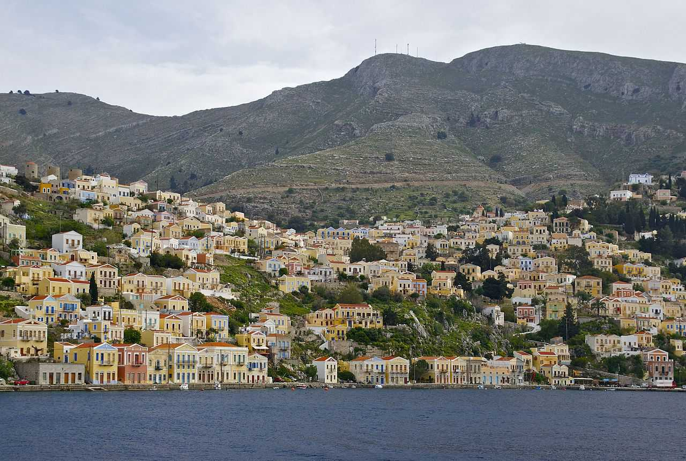

Slide 7
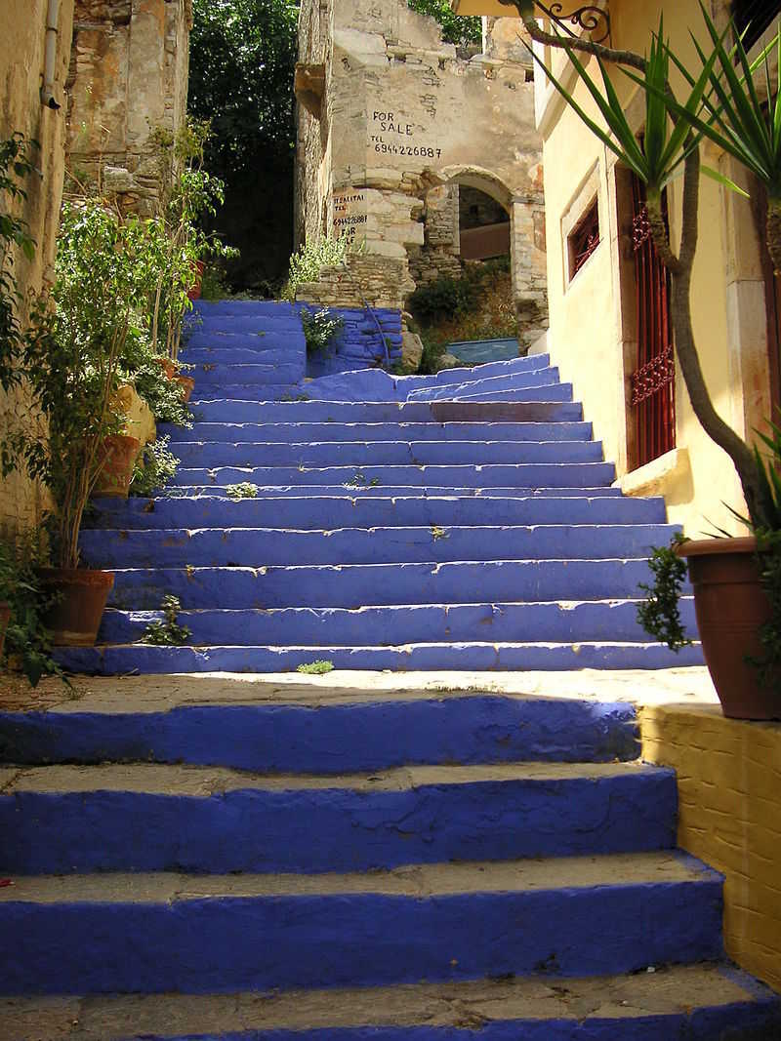

Slide 8
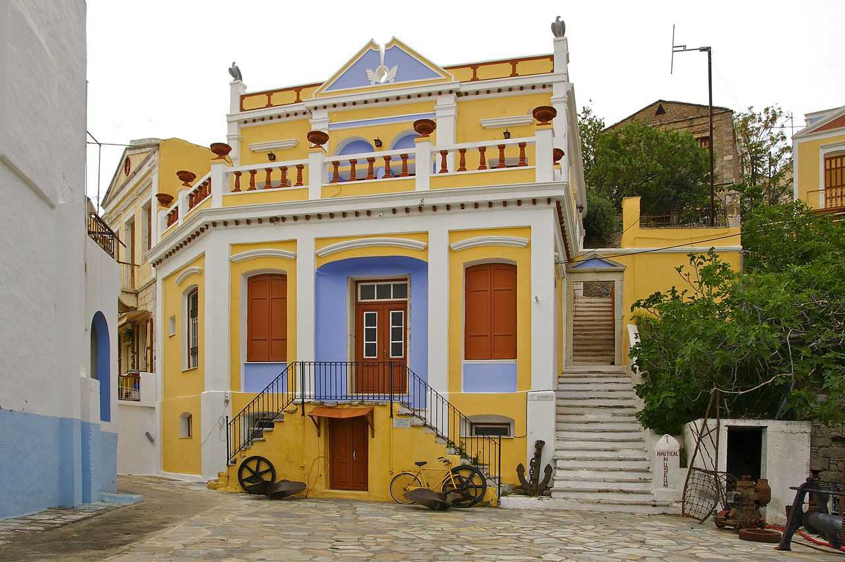

Slide 9
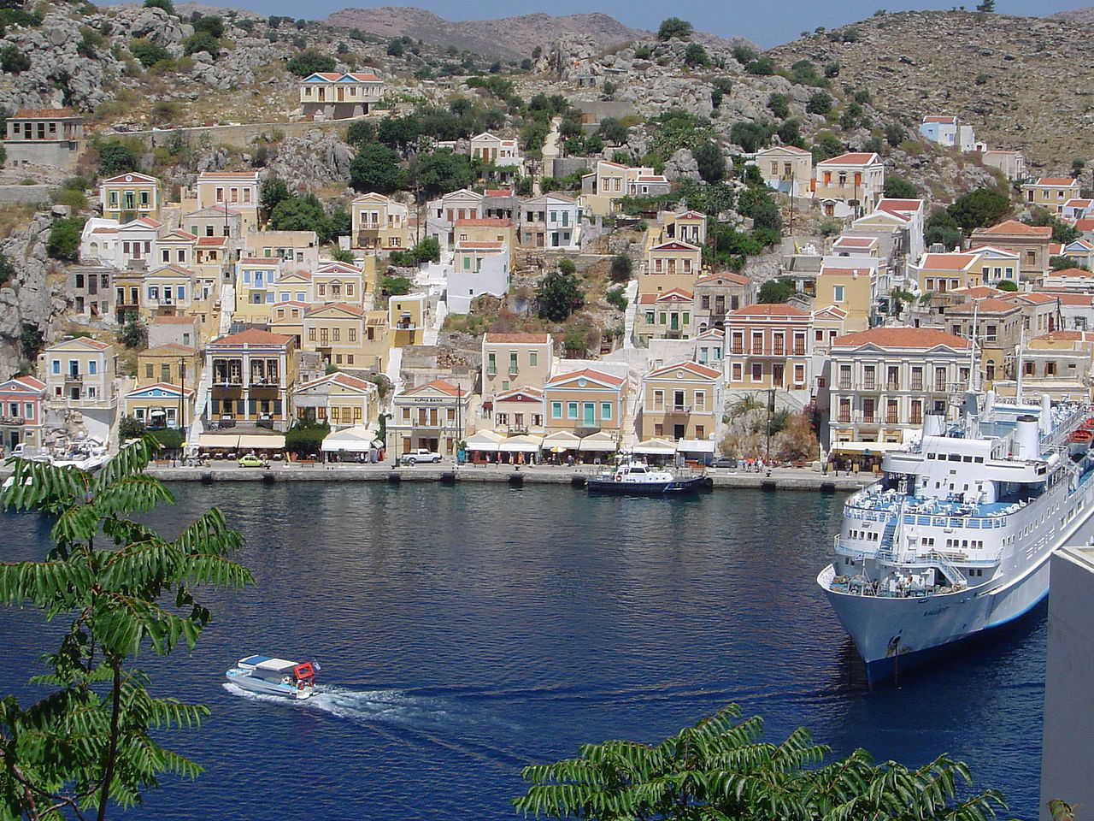

Slide 10
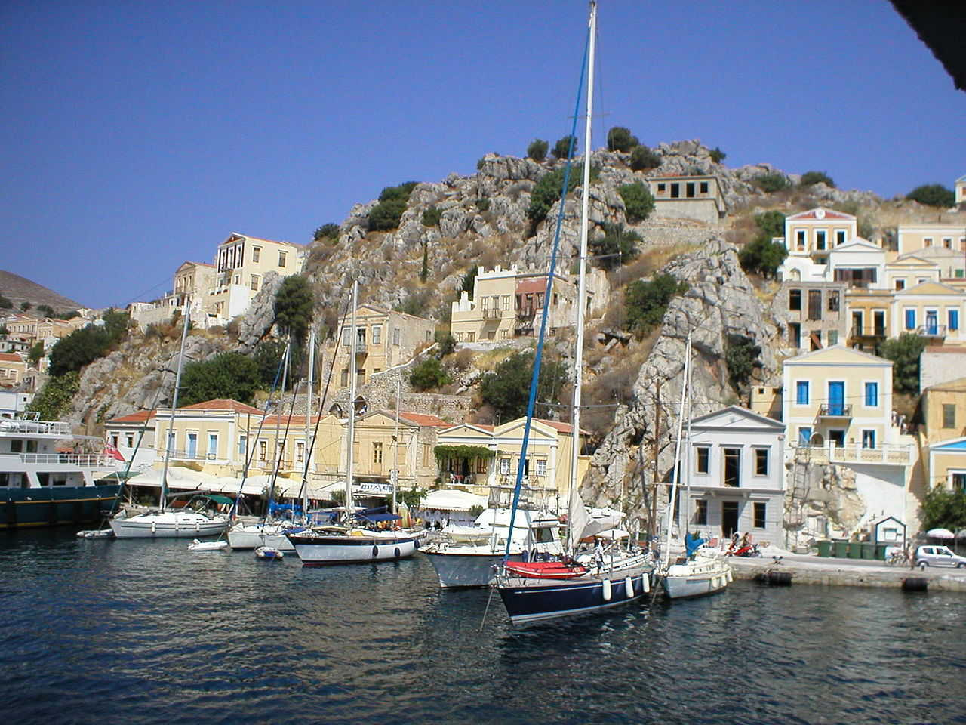

Slide 11
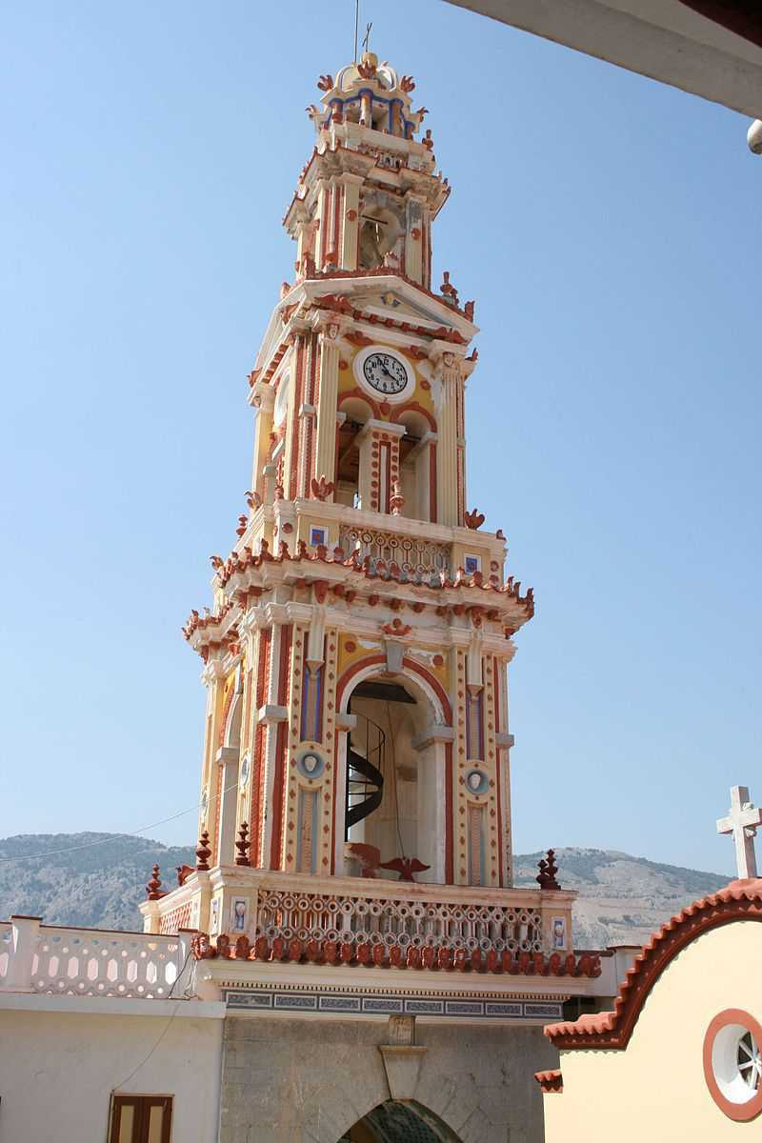

Slide 12
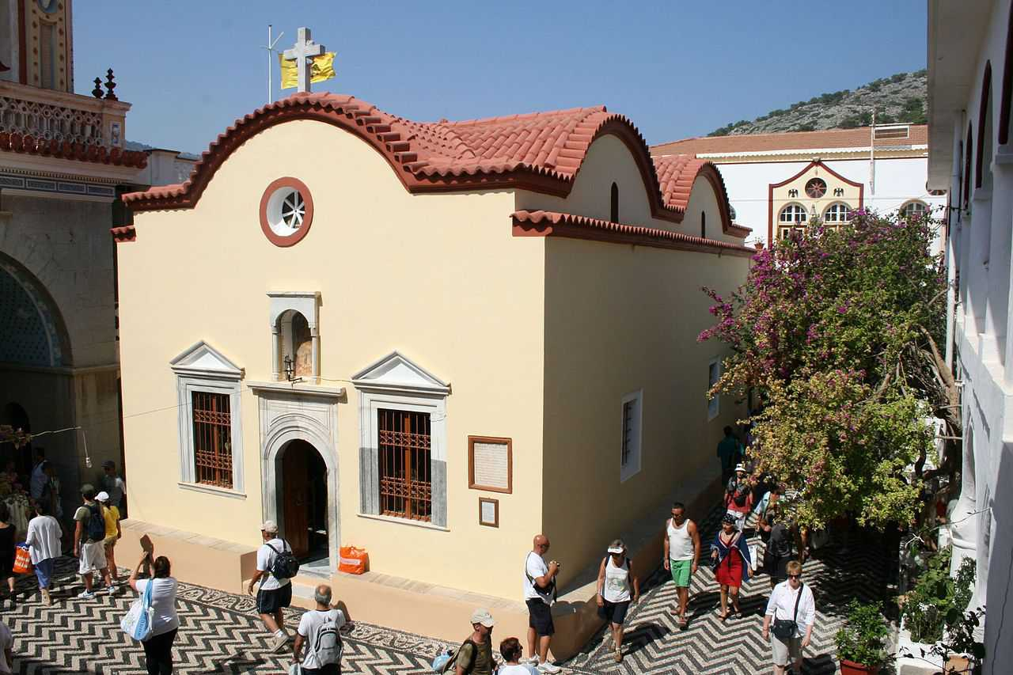

Slide 13
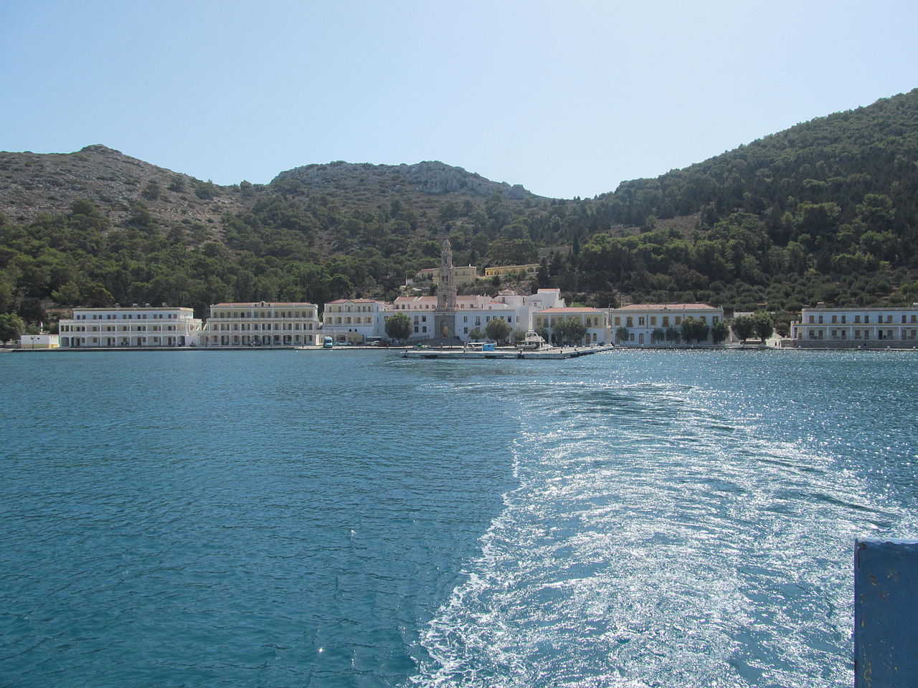

Slide 14
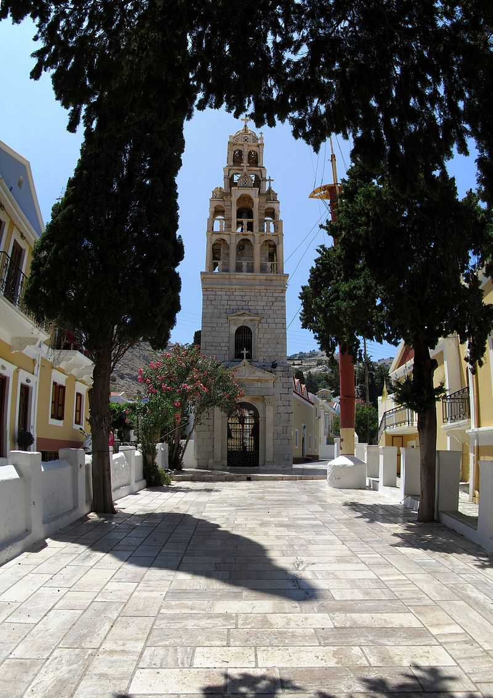

Slide 15
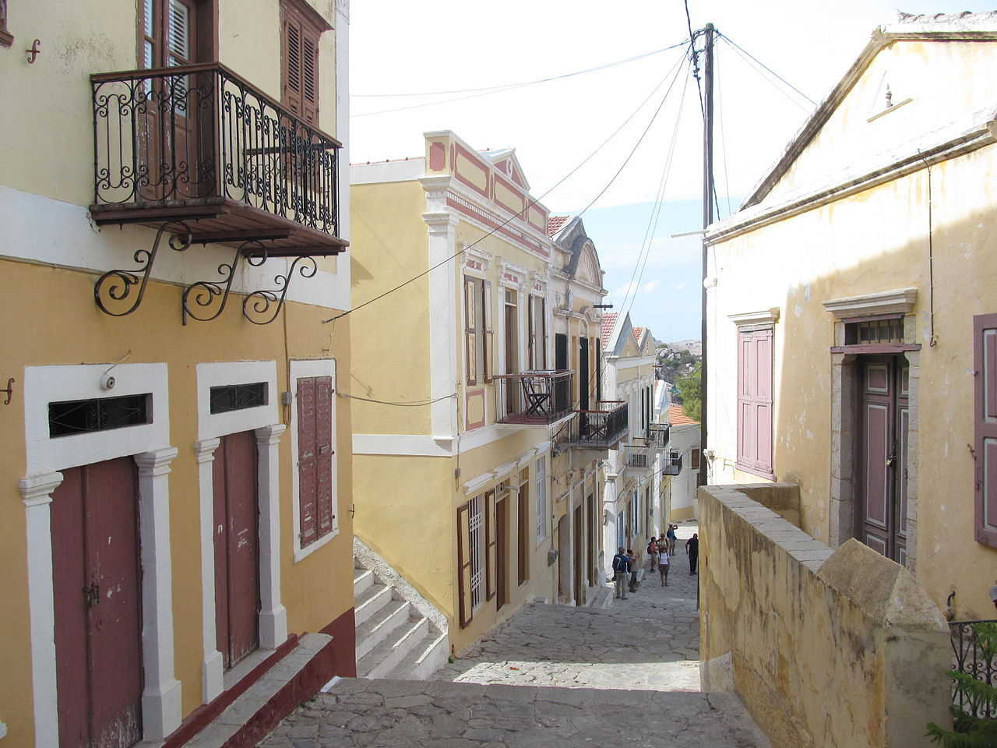

Slide 16
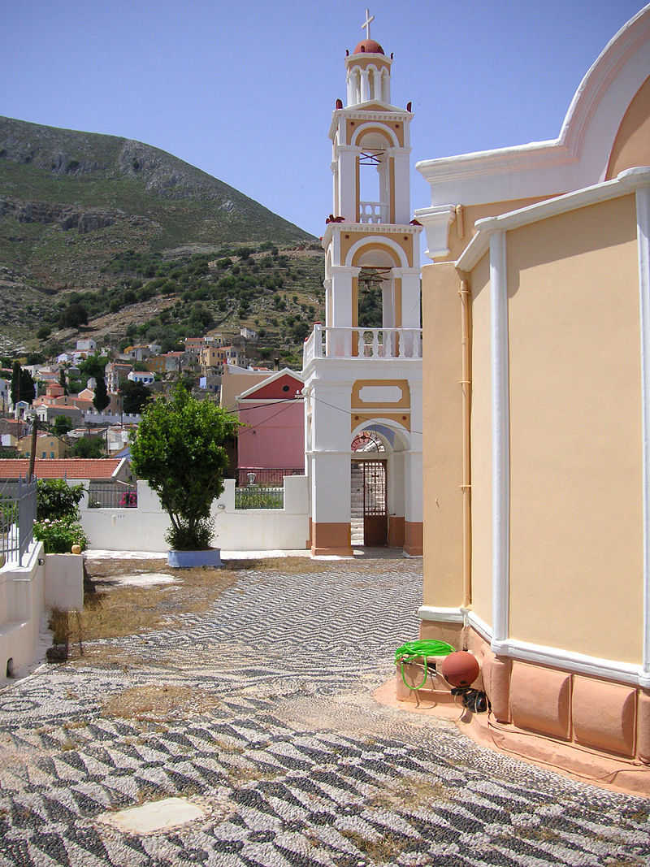

Slide 17
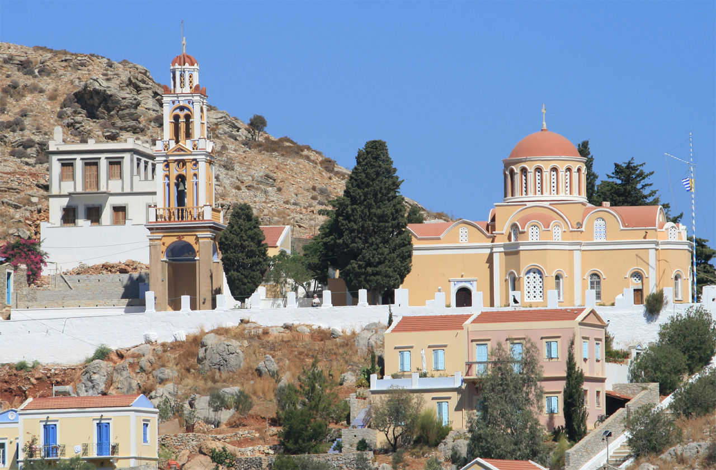

Slide 18
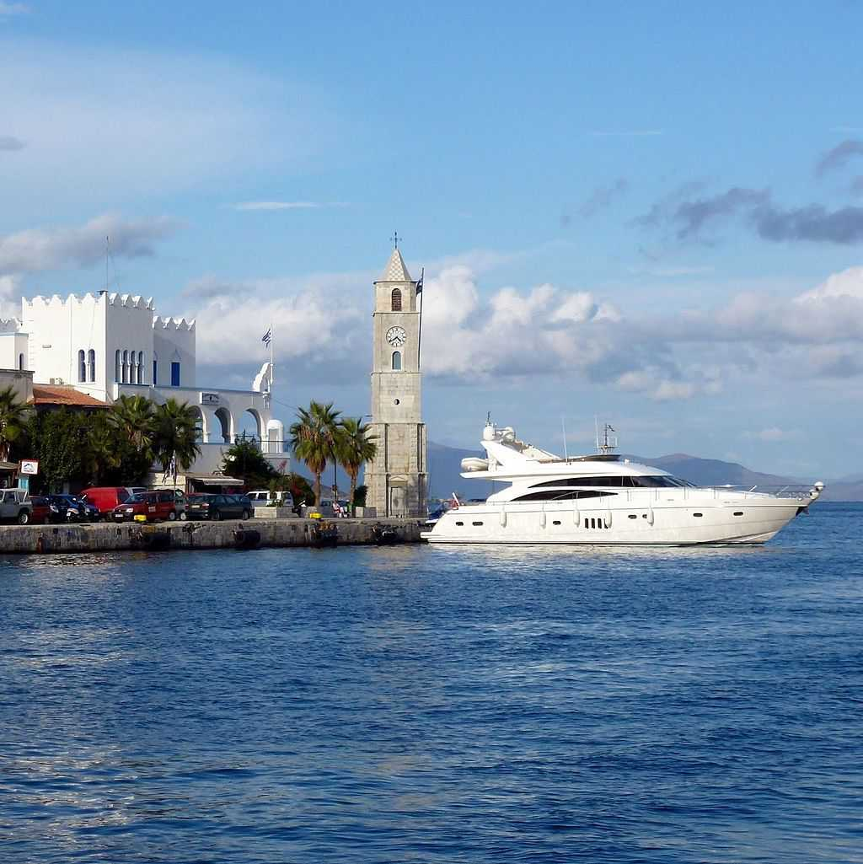

Slide 19
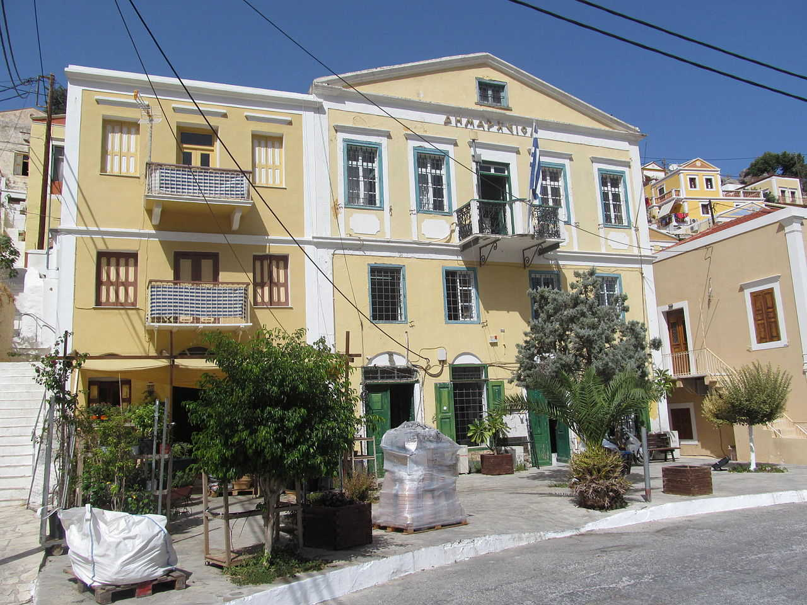

Slide 20
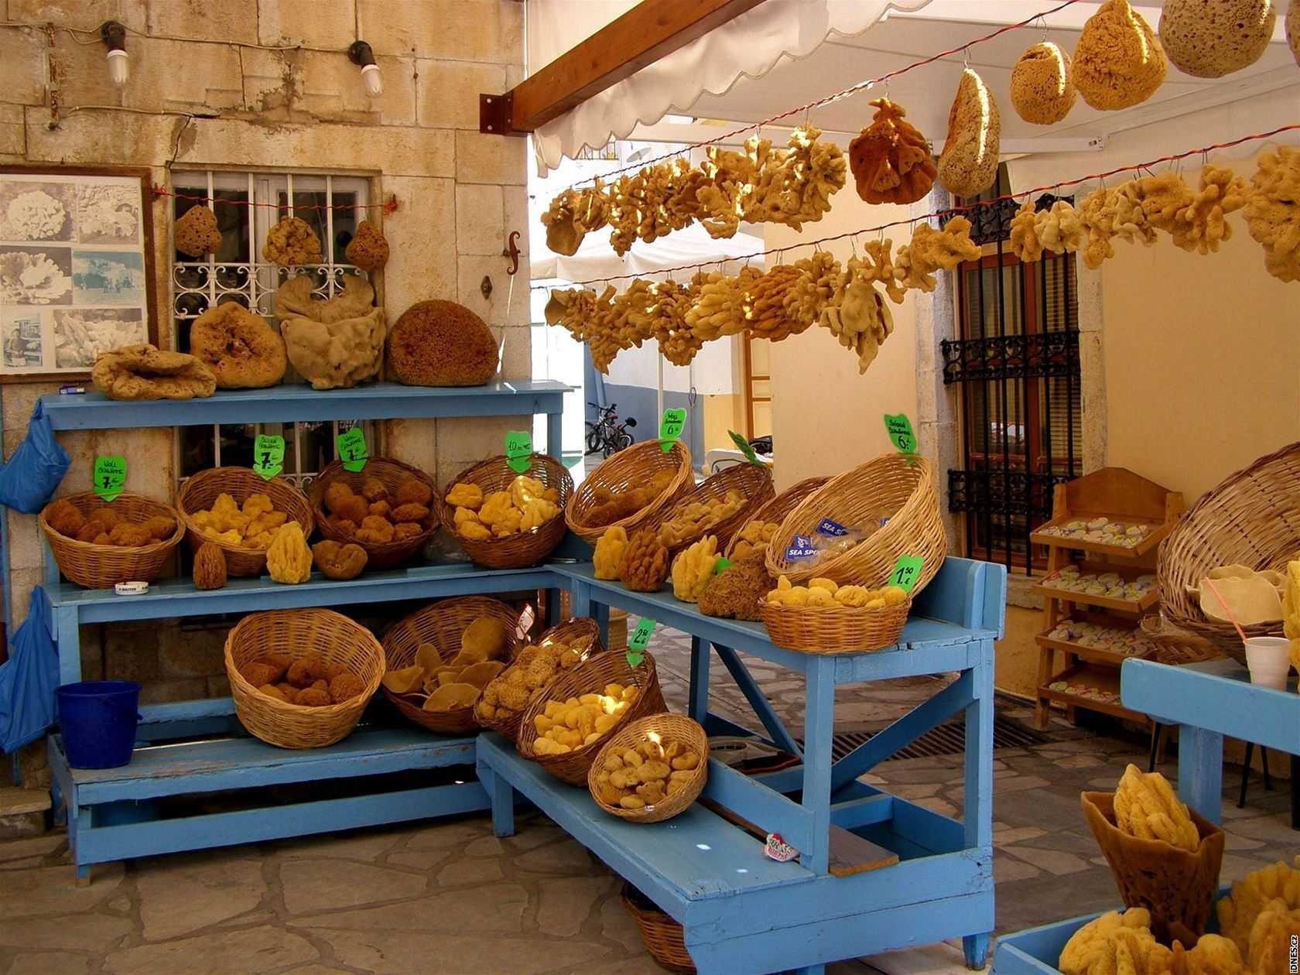

Slide 21
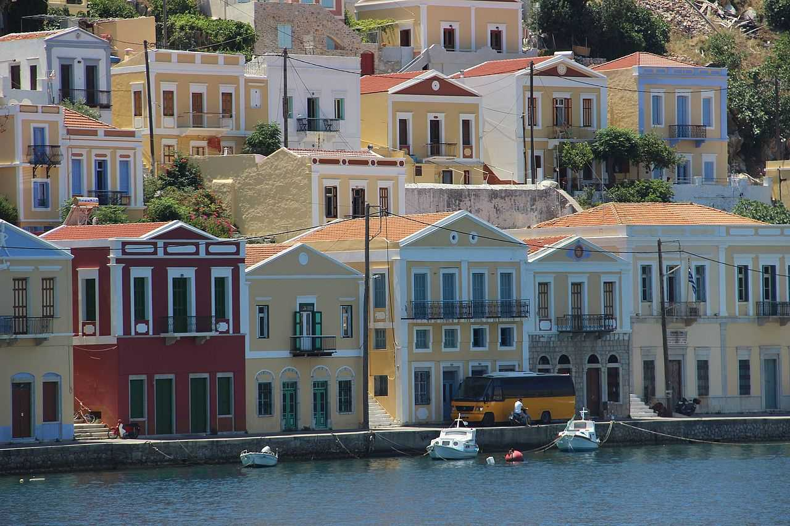

Slide 22
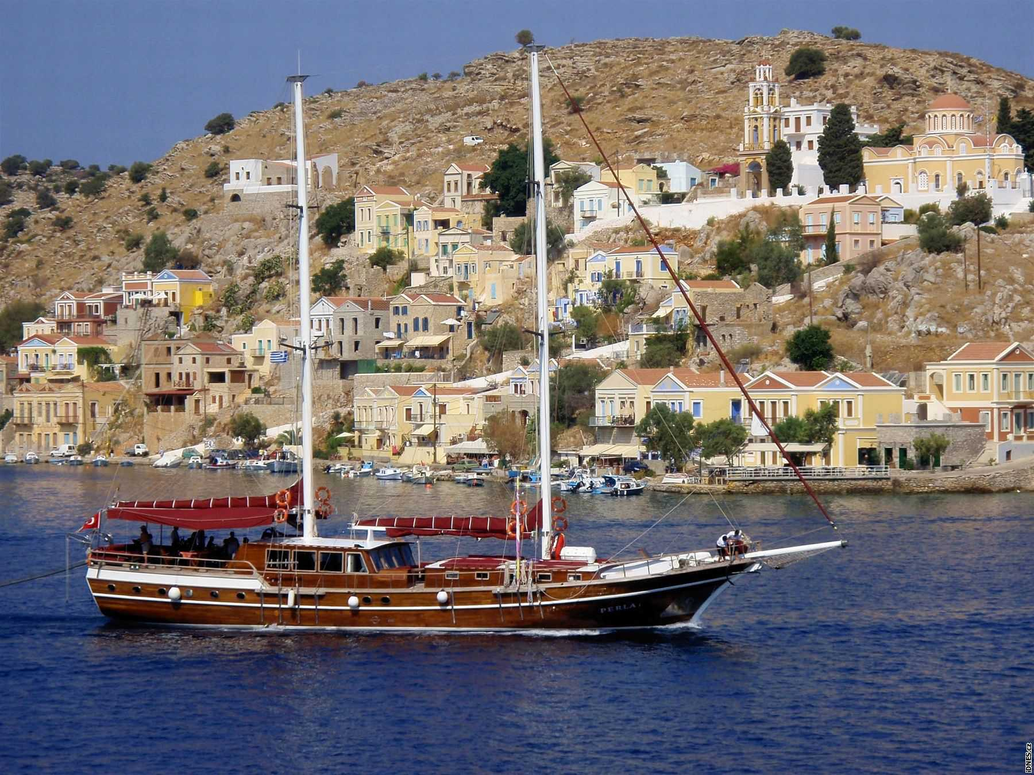

Slide 23
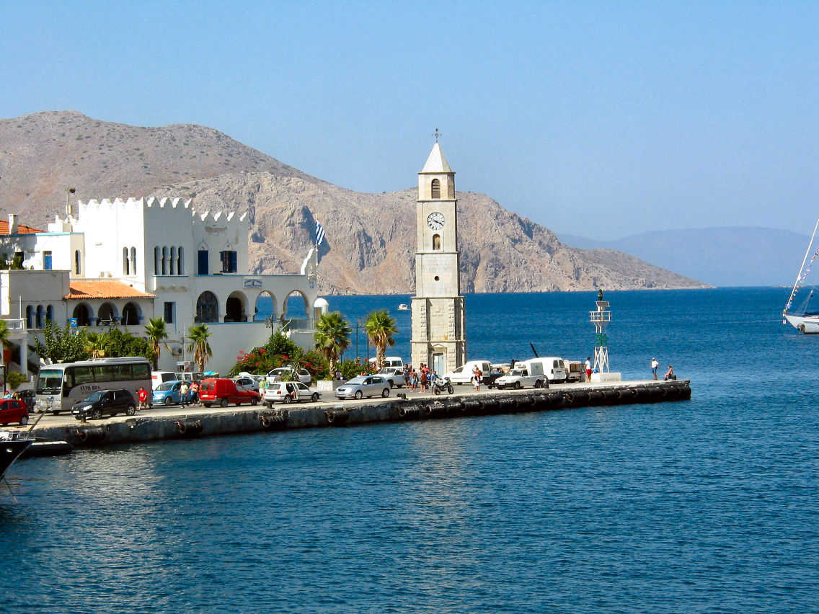
Yveta

Slide 24


PPS of Own Creation
PPS from Internet
Dedication
Funnys
Health
History and Art
Love
Nature and Sciences
Places
Politics
Reflection
Religious
Special Dates
Dedication
Funnys
Health
History and Art
Love
Nature and Sciences
Places
Politics
Reflection
Religious
Special Dates
Visit us in:
If you want to receive our powerpoints in your email subscribe here:

