Slide 1
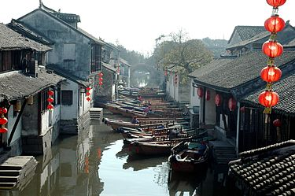
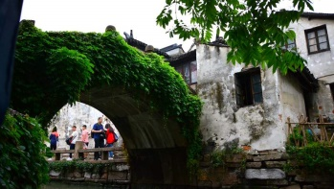
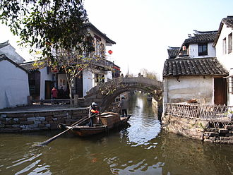
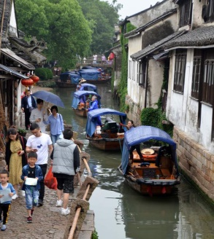
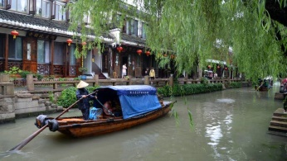
Zhouzhuang Water Town – China (中国)
Zhouzhuang (周庄) is a town famous for its canals in Jiangsu province, China. It is located within the administrative area of Kunshan, 30 km southeast of the city center of Suzhou.
Zhouzhuang is a popular tourist destination, classified as a AAAAA scenic area by the China National Tourism Administration. It is one of the most famous water townships in China, noted for its profound cultural background, the well
Zhouzhuang Water Town
China
中国 (Zhōngguó)
May 2018
preserved ancient residential houses and the elegant watery views. It has been called the “Venice of the East“.
In the Spring and Autumn period (770 BC-476 BC), Zhouzhuang Suzhou was a part of the fief Yaocheng and called Zhenfengli. After being donated to Full Fortune (Quanfu) Temple by Zhou Digong, a very devout Buddhist, in 1086 during the Northern Song Dynasty (960-1127), Zhouzhuang got its present name.
In 1984, 38 canvases of the notable painter, Chen Yifei, were exhibited in a New York gallery of Armand Hammer, chairman of Occidental Petroleum Corporation. "Memory of Hometown", which depicted the Double Bridges, was one of the items on display and
has gained the world's attention for Zhouzhuang. The painting was chosen to be the first-day cover of the United Nations' postage stamp in 1985.
© Isabela & Miki Pitish
(Wikipedia)

Slide 2
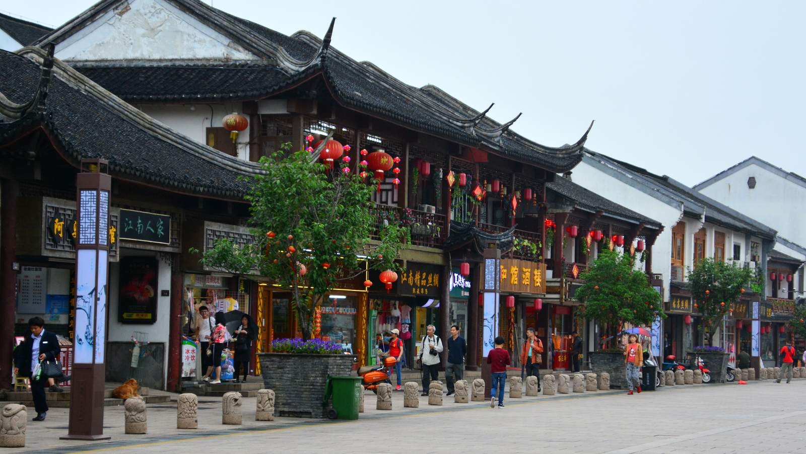
© Iza & Miki

Slide 3
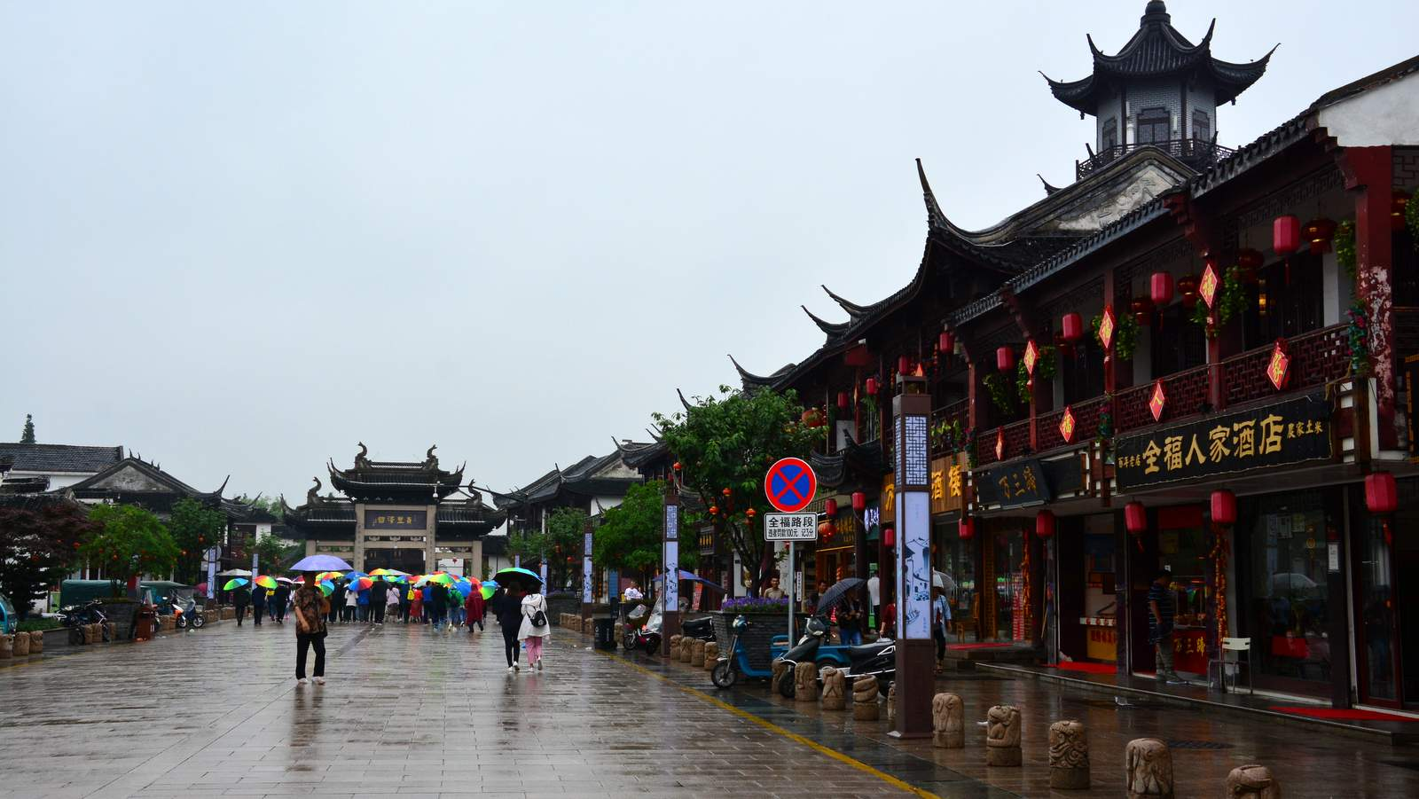
© Iza & Miki

Slide 4
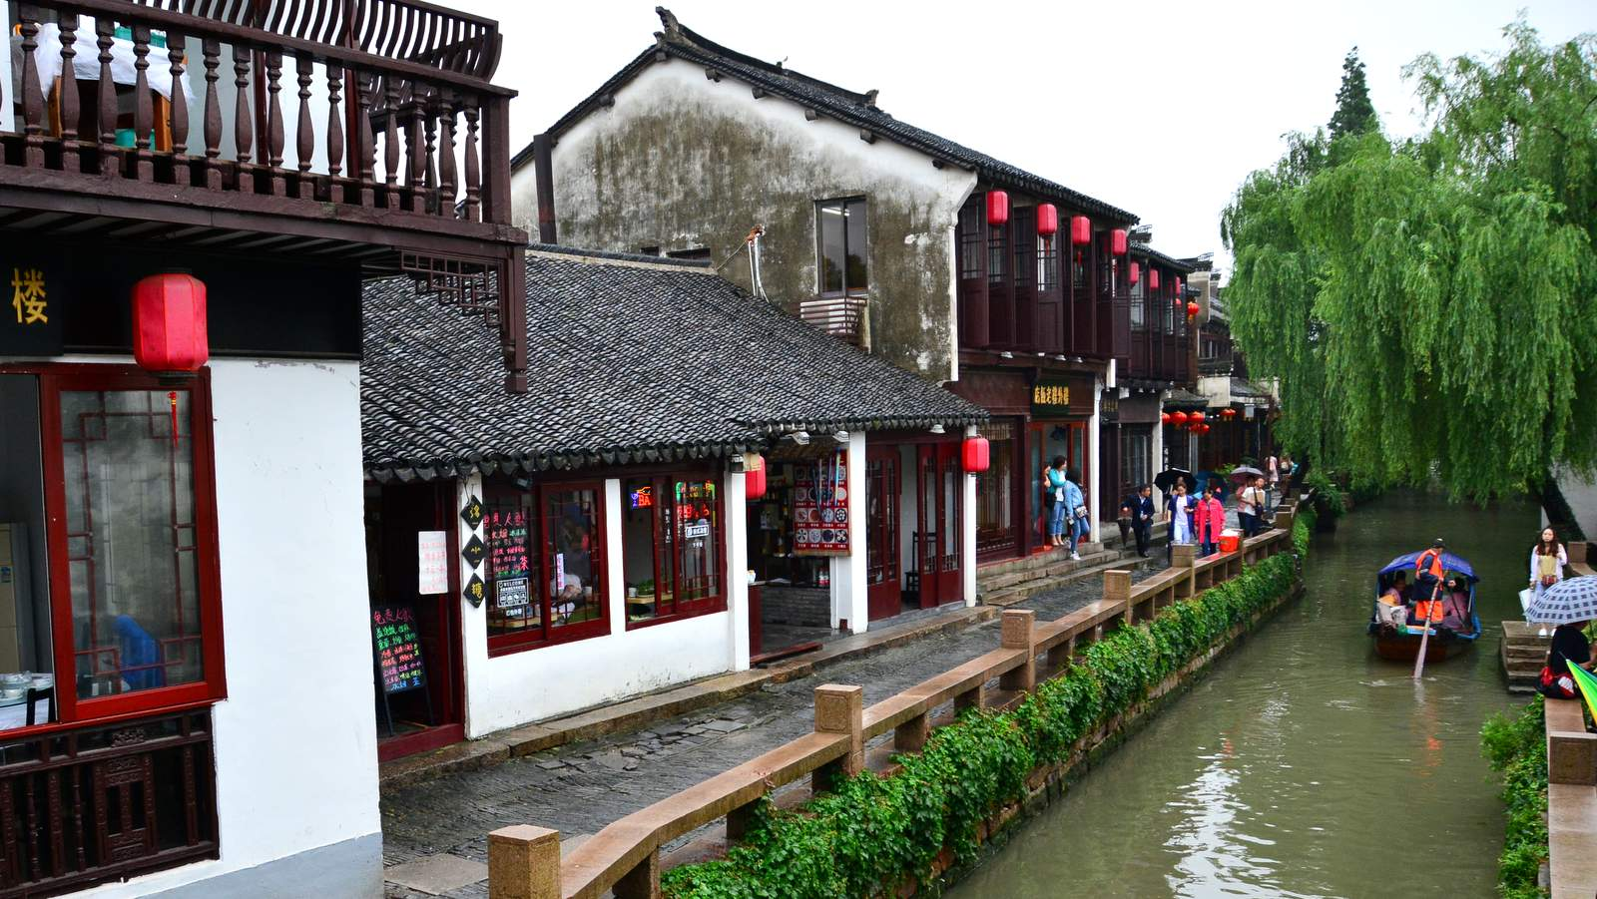
© Iza & Miki

Slide 5
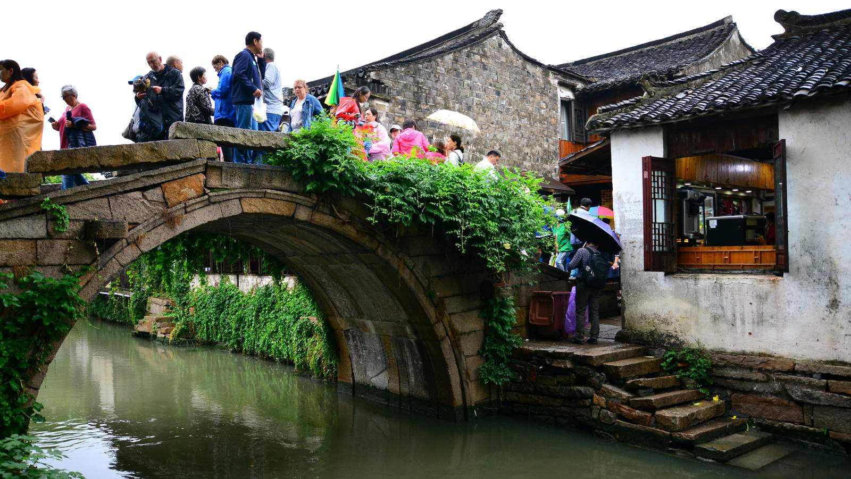
© Iza & Miki

Slide 6
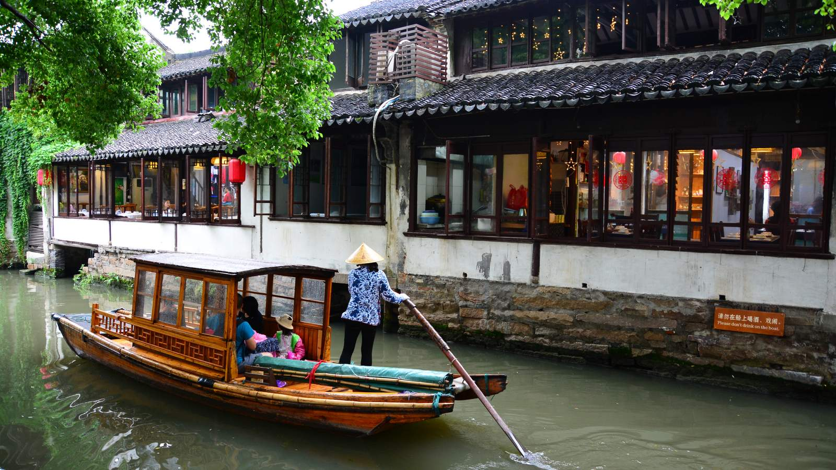
© Iza & Miki

Slide 7
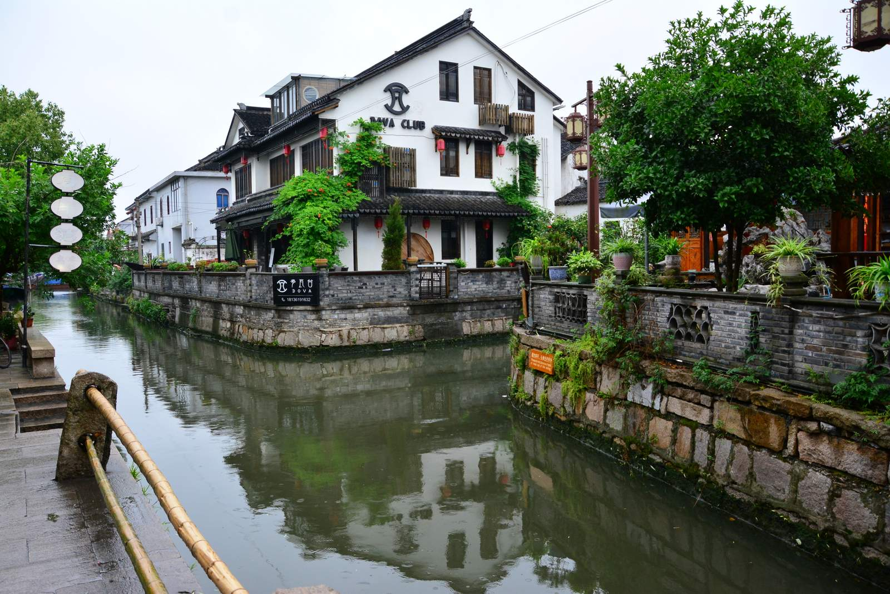
© Iza & Miki

Slide 8
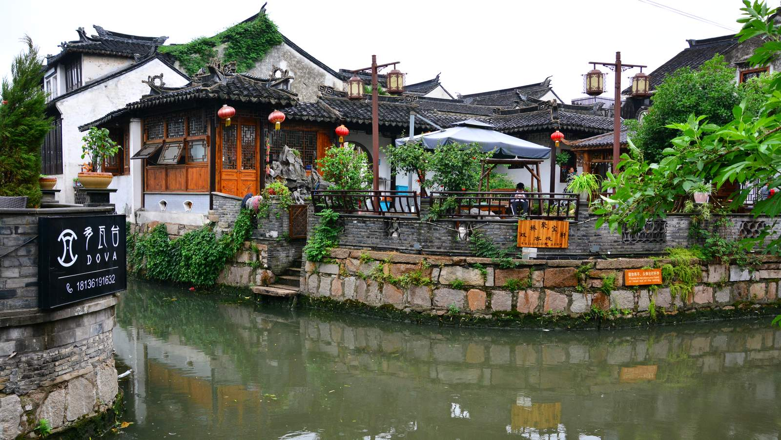
© Iza & Miki

Slide 9
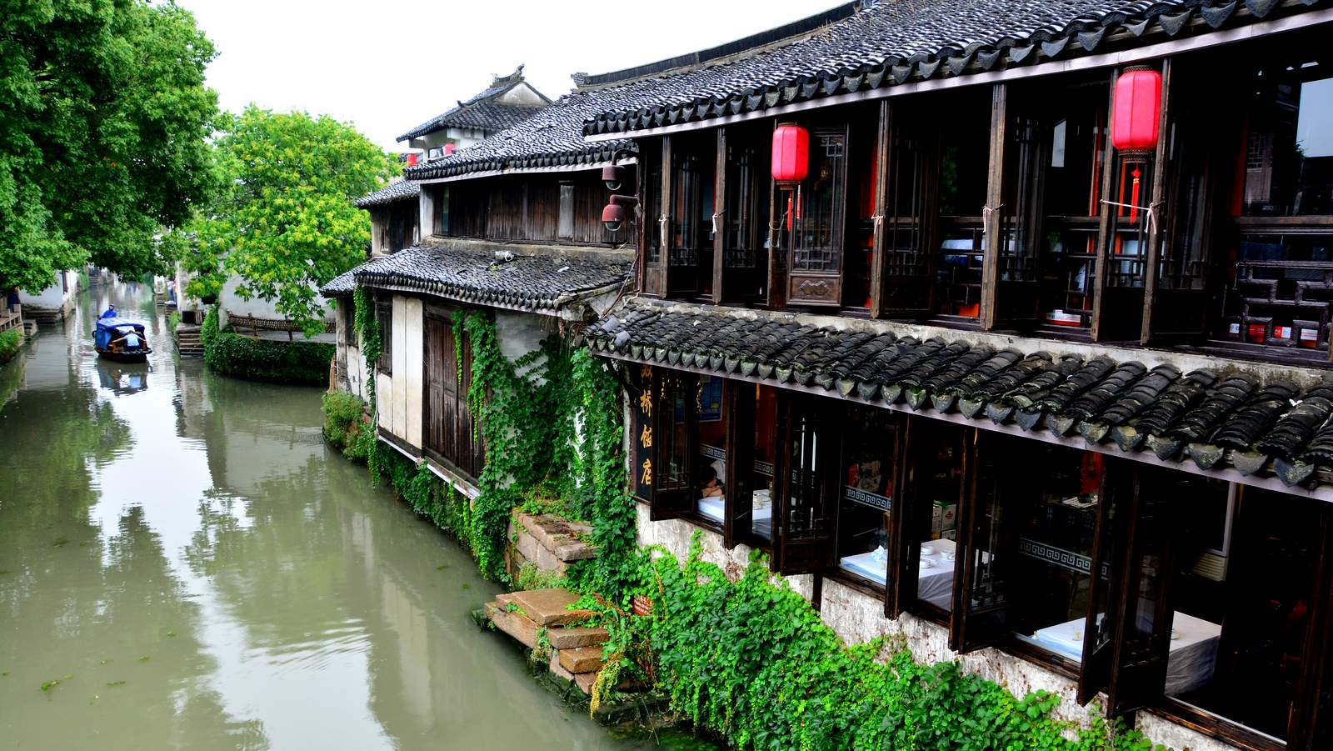
© Iza & Miki

Slide 10
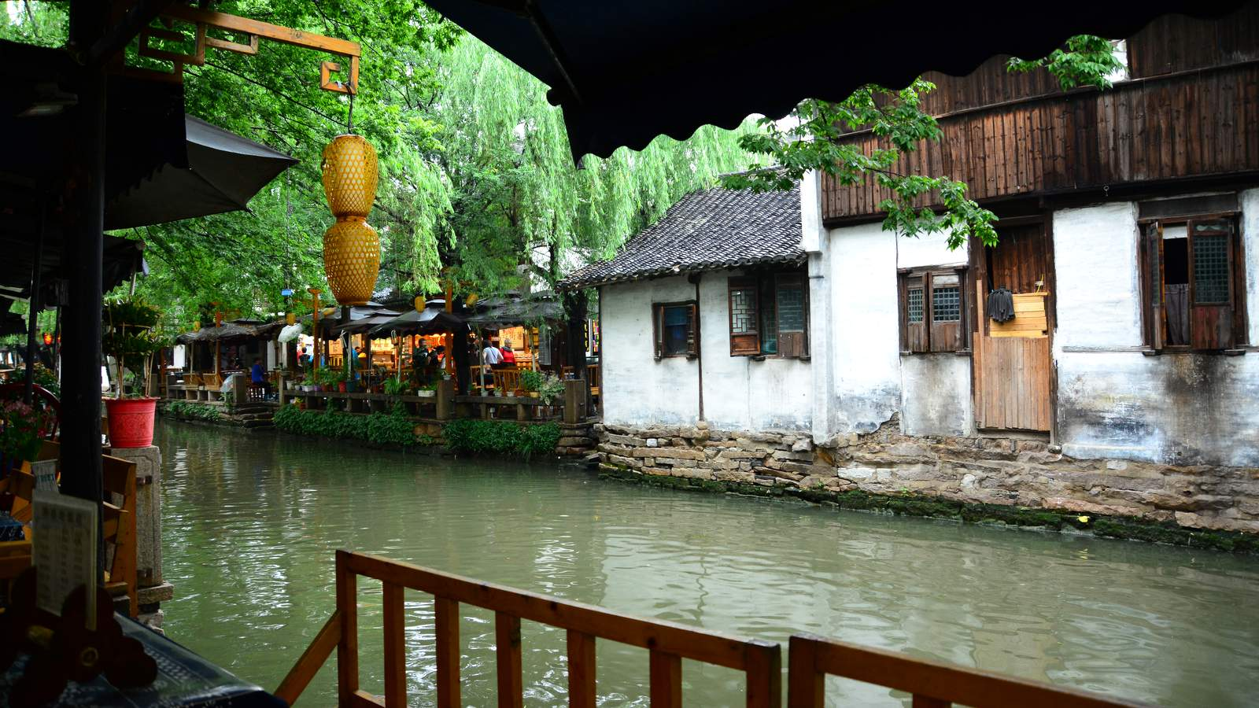
© Iza & Miki

Slide 11
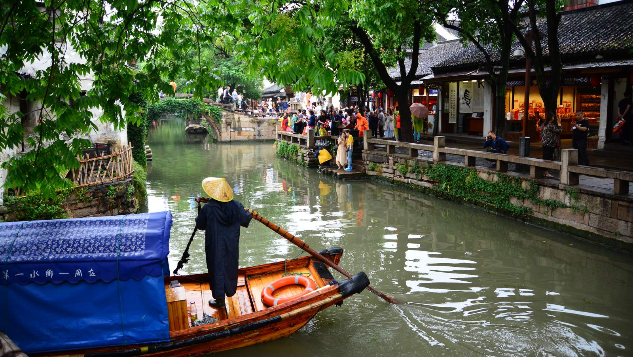
© Iza & Miki

Slide 12
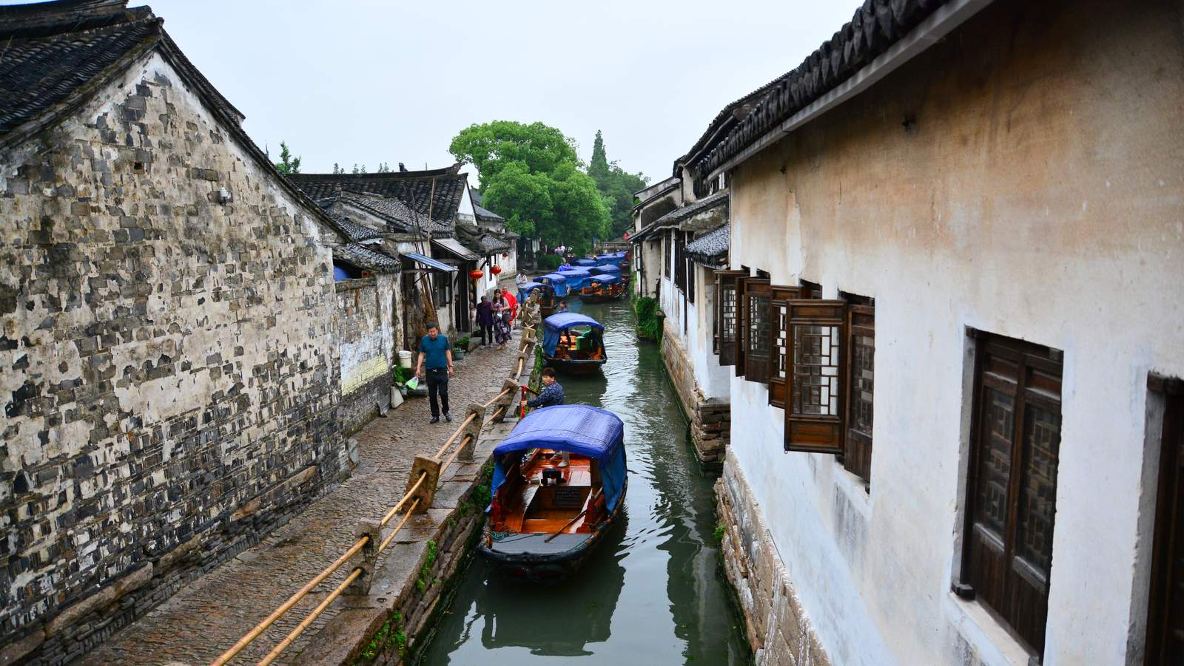
© Iza & Miki

Slide 13
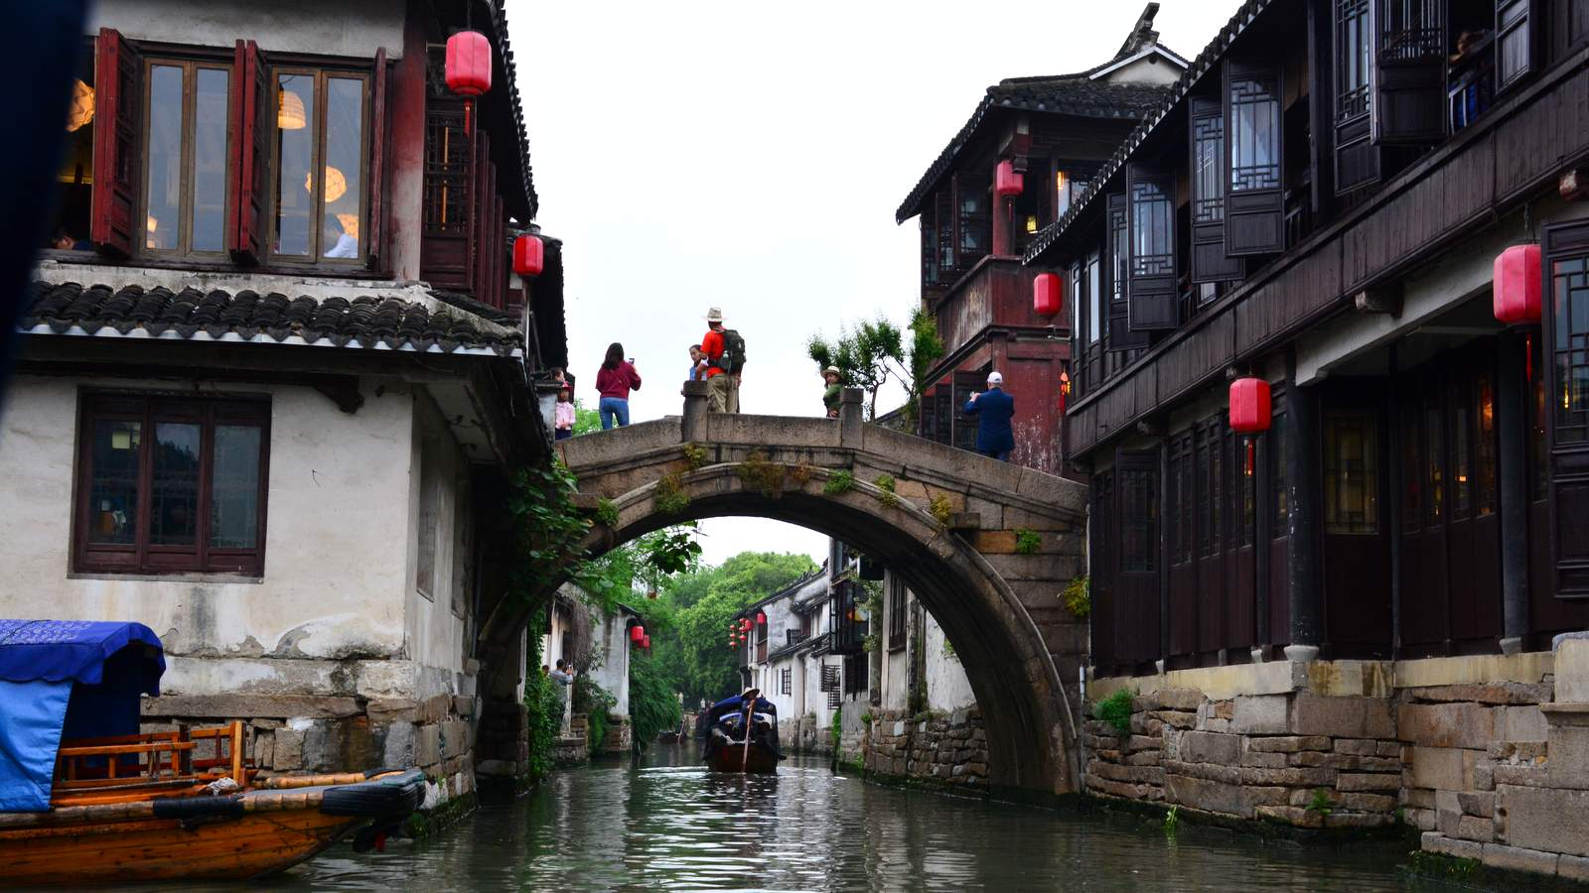
© Iza & Miki

Slide 14
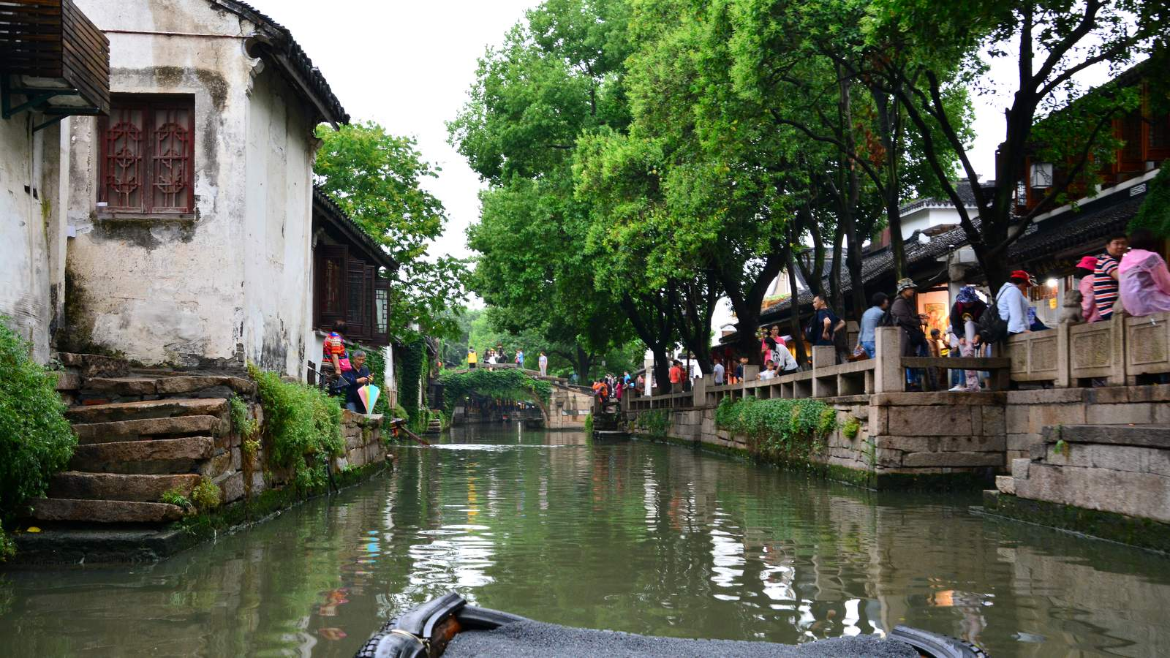
© Iza & Miki

Slide 15

© Iza & Miki

Slide 16
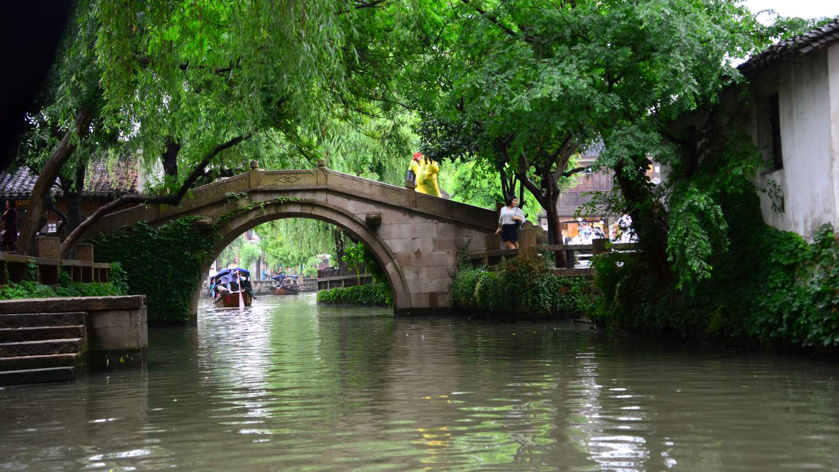
© Iza & Miki

Slide 17
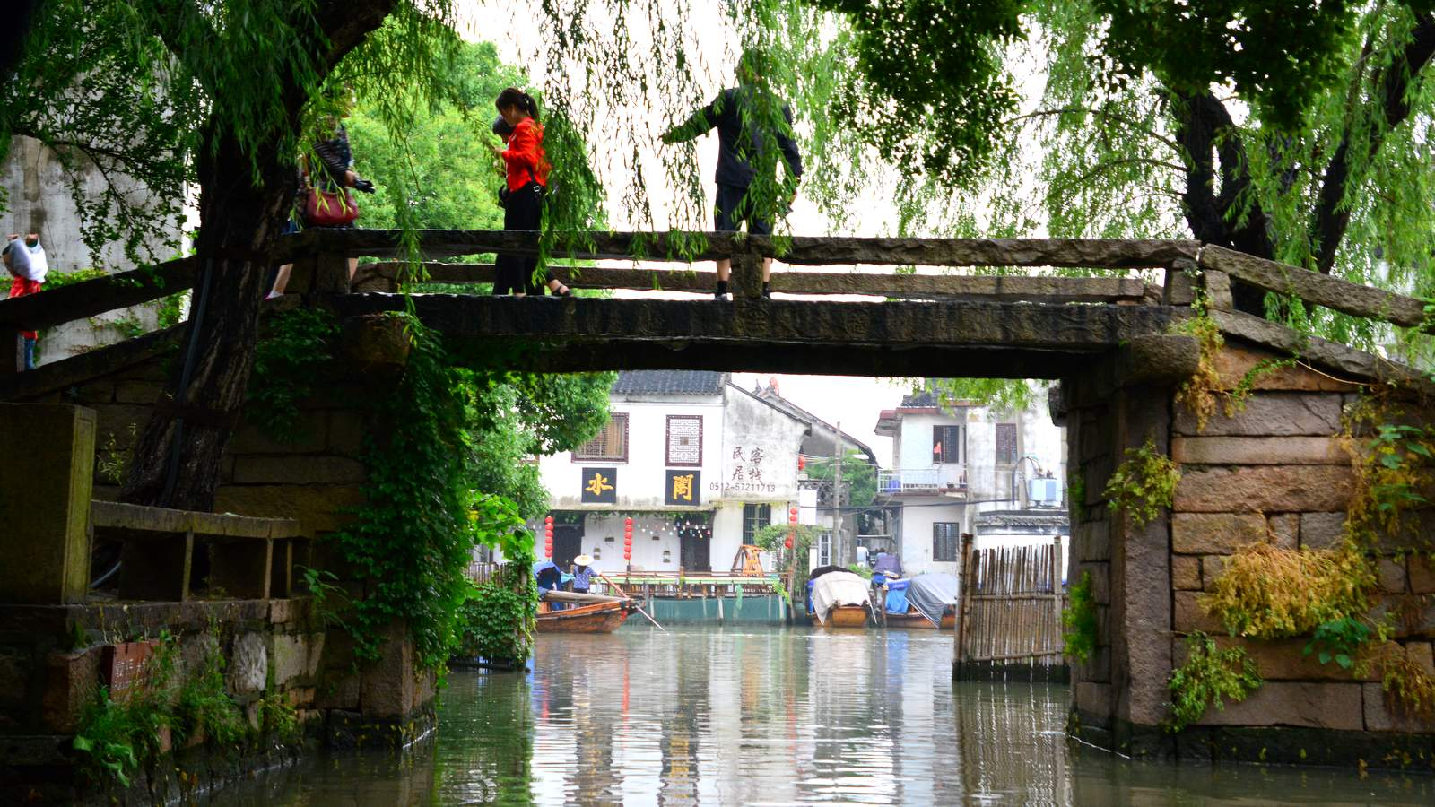
© Iza & Miki

Slide 18

© Iza & Miki

Slide 19
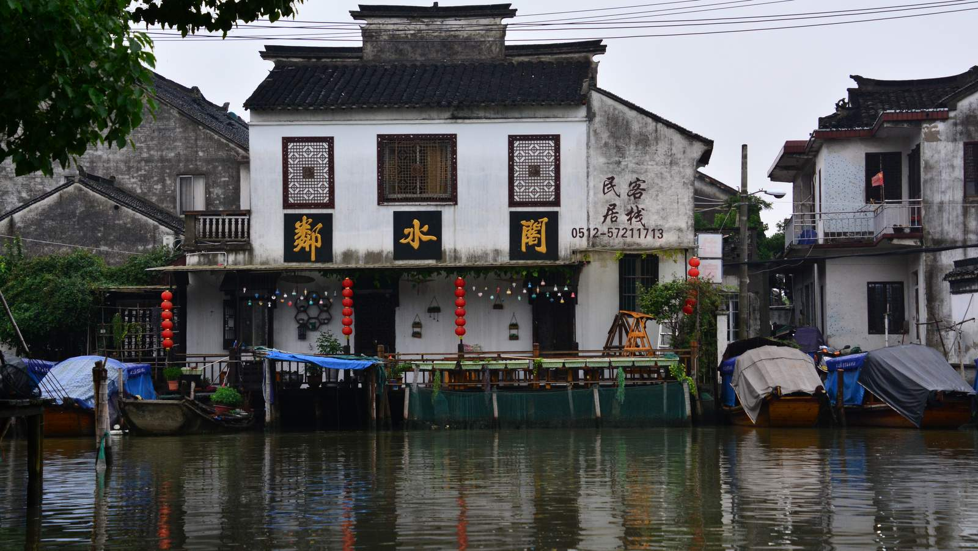
© Iza & Miki

Slide 20
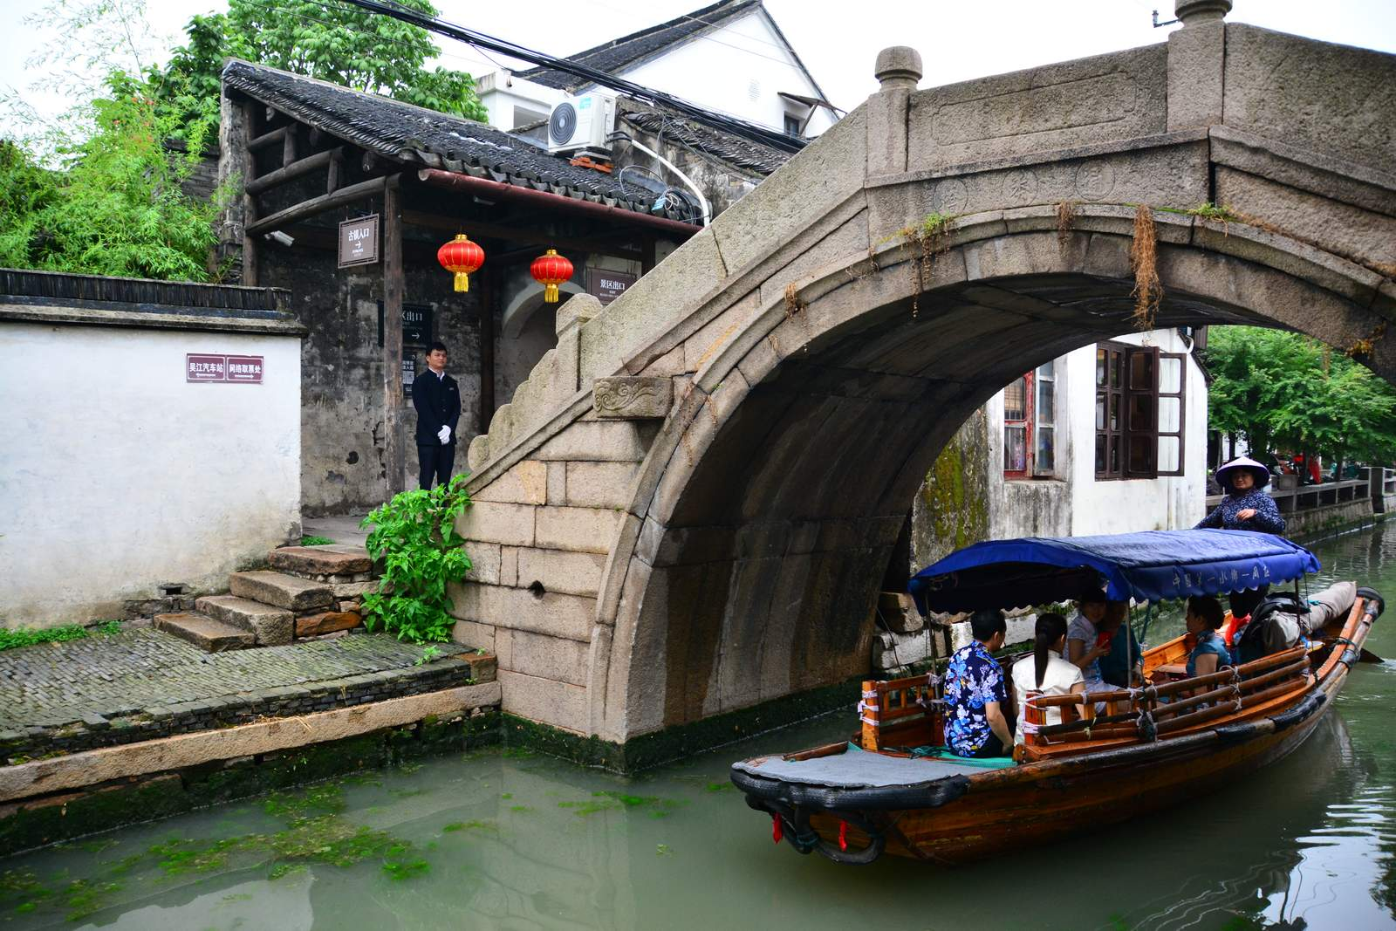
© Iza & Miki

Slide 21
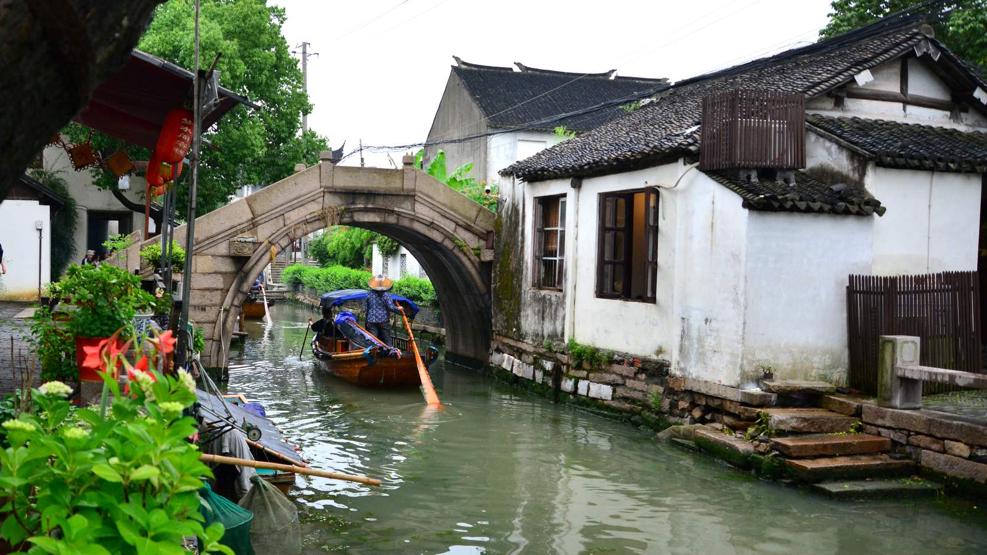
© Iza & Miki

Slide 22
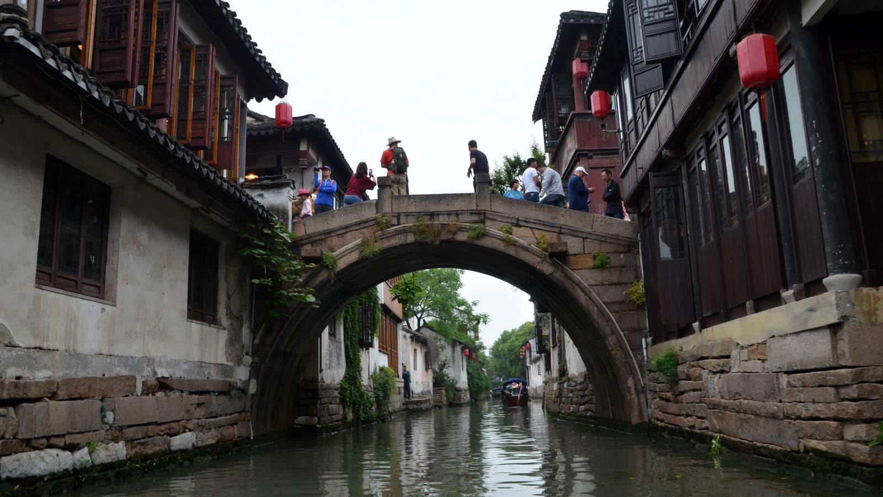
© Iza & Miki

Slide 23
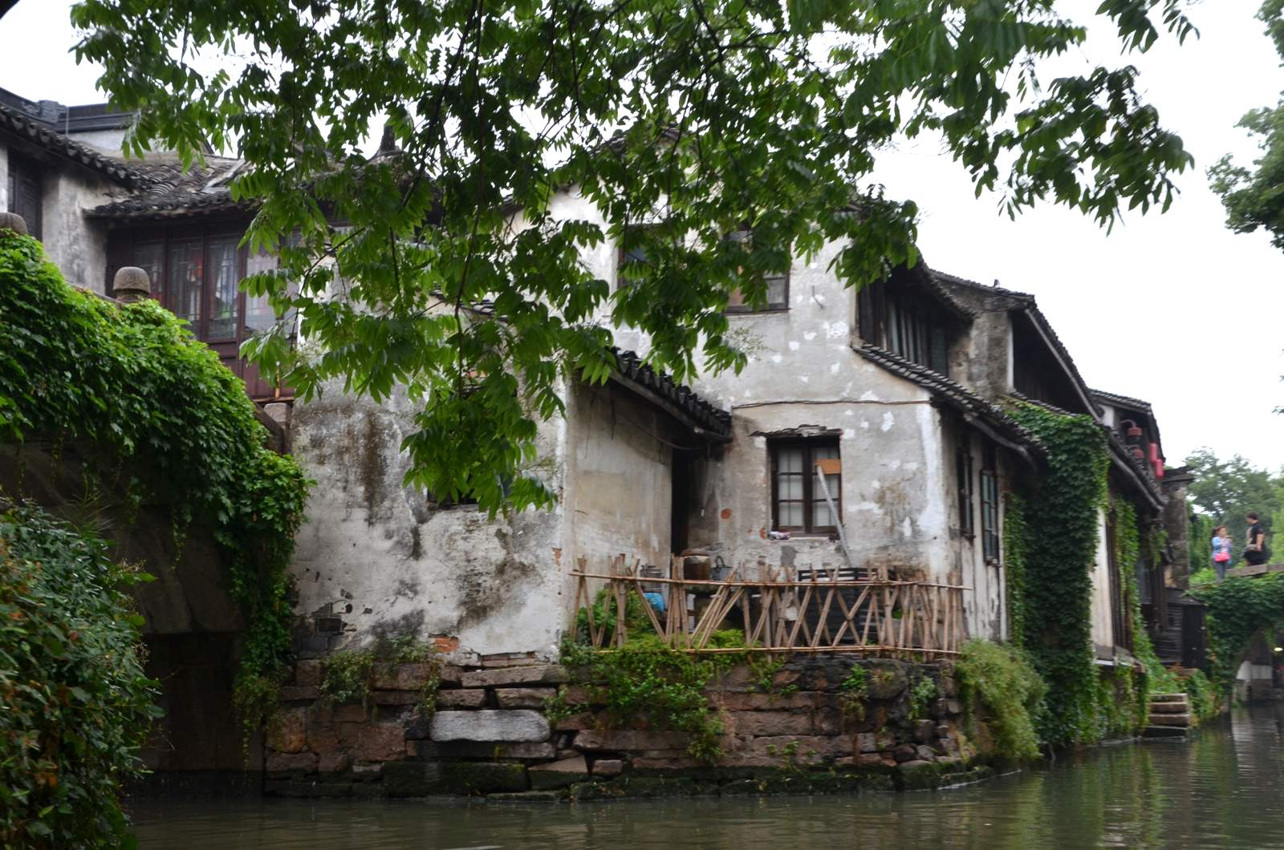
© Iza & Miki

Slide 24
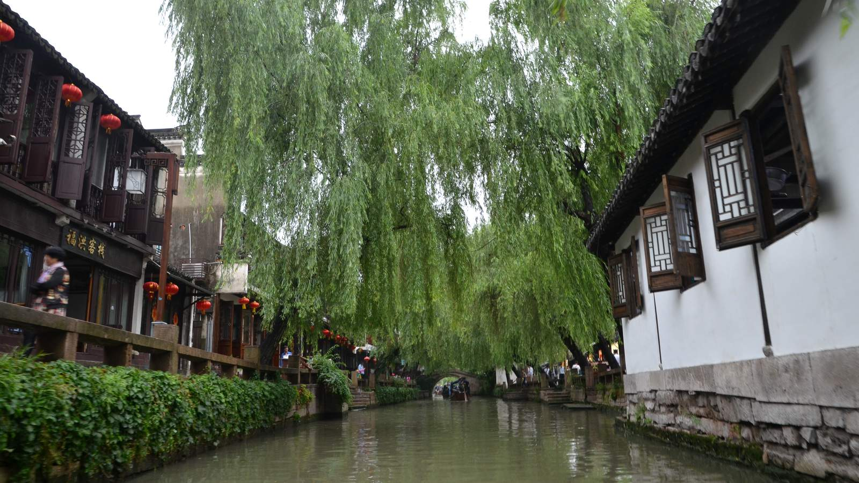
© Iza & Miki

Slide 25
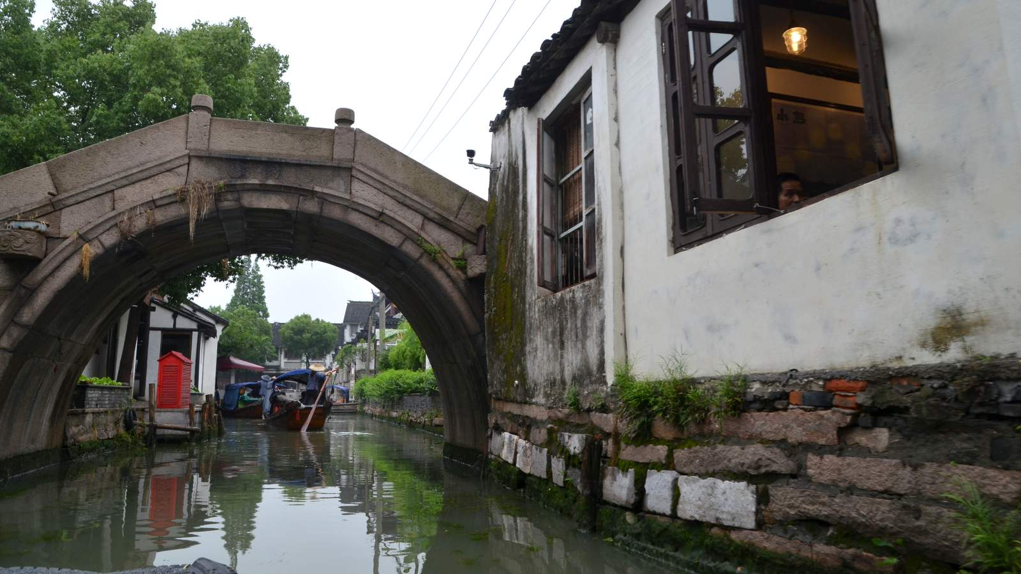
© Iza & Miki

Slide 26
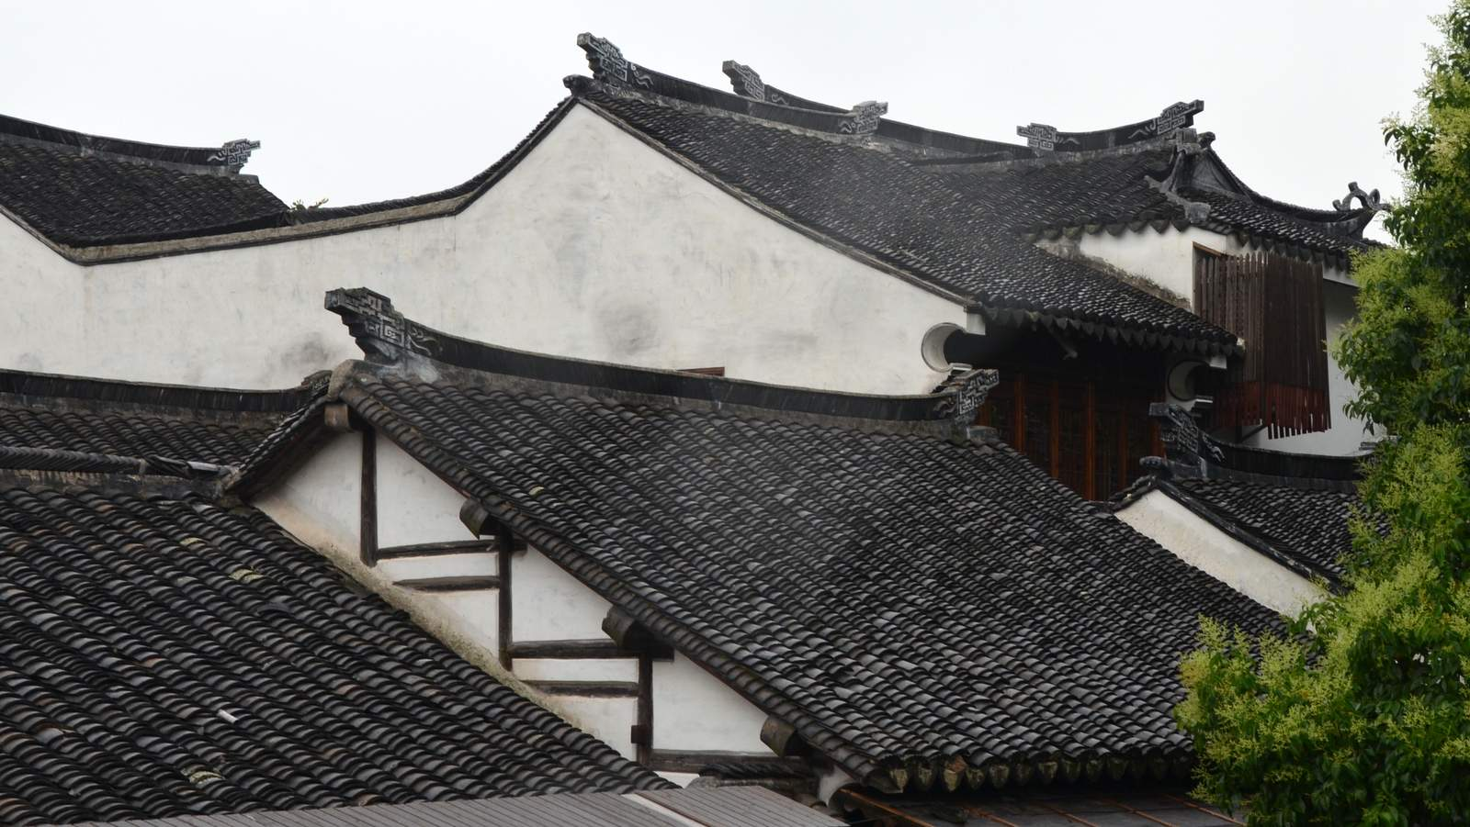
© Iza & Miki

Slide 27
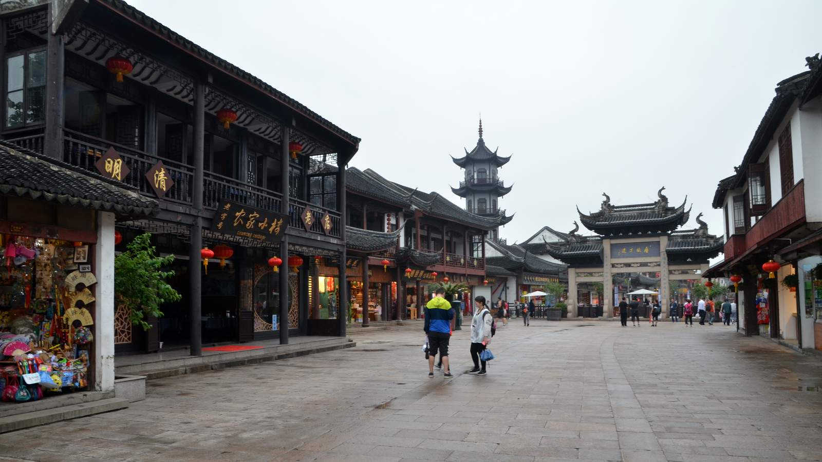
© Iza & Miki
Created by Isabela & Miki Pitish
Chinese Classical Music

